Slide 1
SY20 District Goals & Action Plan
(Equity Implementation Plan)
September 24, 2019 BOE Meeting

Slide 2
Purpose of Tonight’s Special Report:
Outline SY20 Goals & Equity Implementation Plan:
Agreement that these are the correct big rocks?
What is the expectation from the BOE on how you would like to monitor?

Slide 3
D97 Vision 4ALL
Source: BOE Policy 1:30

Slide 4
The state that would be achieved is a student’s success and well-being was no longer predictable by any social, cultural or economic factor

Slide 5
Interrupting inequitable practices, examining biases, and creating inclusive & just conditions for all

Slide 6
Ensuring every child receives what they need, when they need it, to develop to their full academic and social potential.

Slide 7
Cultivating the unique gifts, talents & interests that resides in every child.

Slide 8
D97 Vision 4ALL Plan
Source: BOE Policy 1:30

Slide 9
BOE Support of D97 Vision 4ALL Plan:
Source: BOE Policy 7:12

Slide 11
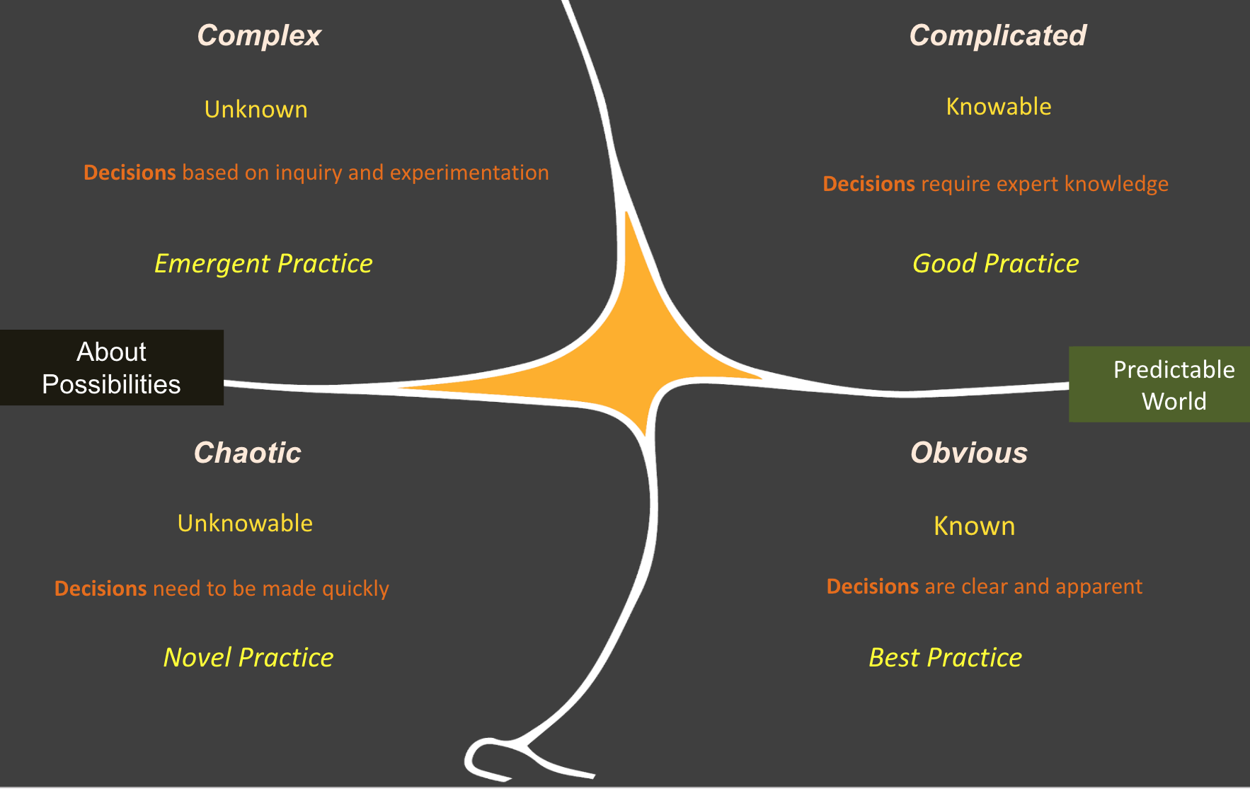
Cynefin Framework: Model for Systems Change

Slide 12
SY20 Plan At A Glance

Slide 13
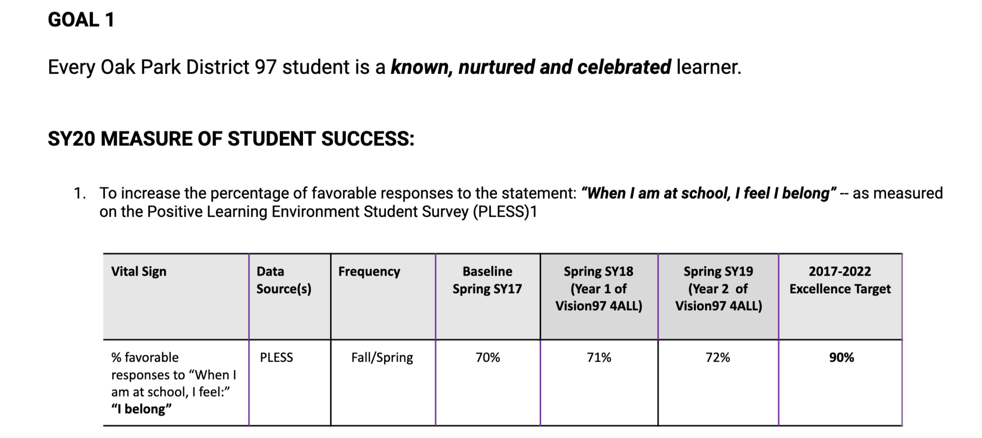
Goal 1

Slide 14
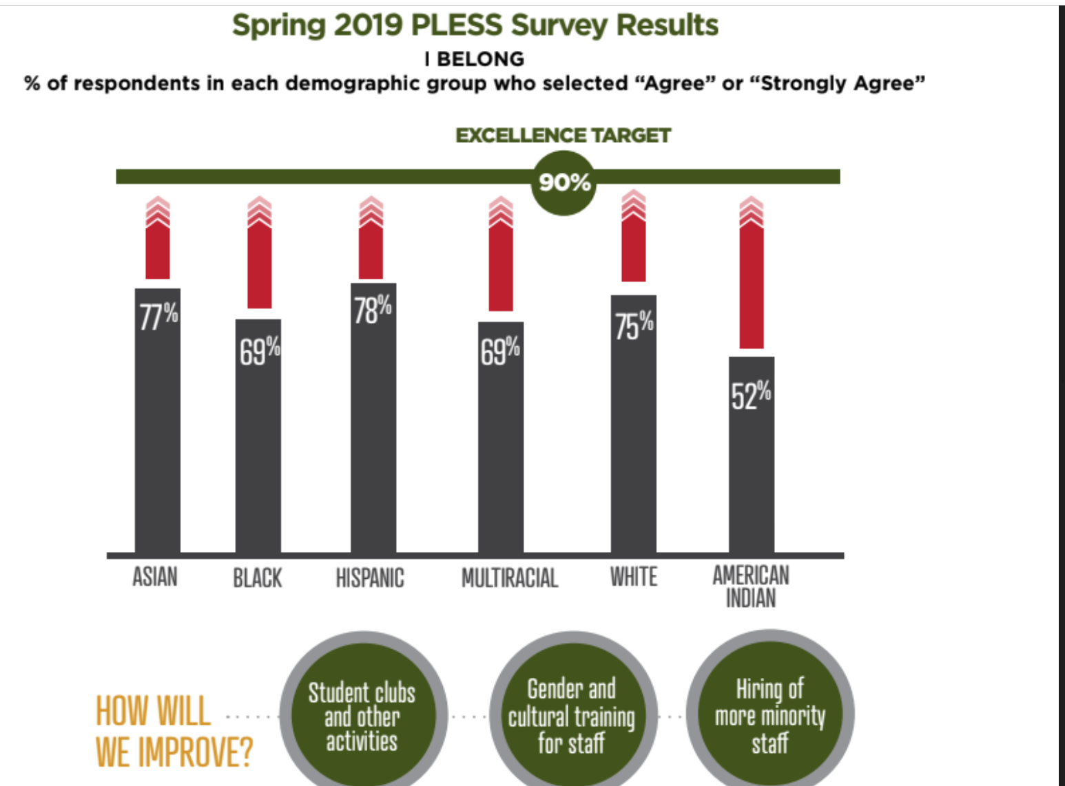
Goal 1: How Will We Improve?
Universal Design for Learning

Slide 15
Goal 1: How will We Measure Our Activities?
Strategy - Recognizing and Valuing Diversity
Tactic - Student Voice and Agency (aka “Student Clubs, Other Activities)
10/10 schools completing Gender Support Team Team Training (by December 2, 2019)
198/360 of selected students participated in Lunch ‘N’ Learns. (November - December 2019)
10/10 schools have an active SJC or book club (by May 2020)
25 students per school active in YEMBA Affinity Space for African American and LatinX students (November 2019 - May 2020)
95% of (Grade 1-8) students participate on PLESS survey (November 2019, May 2020)

Slide 16
Goal 1: How will We Measure Our Activities?
Strategy - Equitable Access
Tactic - Universal Design for Learning (aka “UDL”)
92% of students with disabilities receive specially designed instruction in an inclusive general education setting. (September 2019 - May 2020)
95% of teachers who receive a score of 90% or above on the Quality Indicators of Specially Designed Instruction rubric. (September 2019 - May 2020)
Notes:
UDL is a tactic designed to help increase student participation in general education settings.
D97 will continue our implementation of UDL through the implementation and improvement of our co-teaching practices.

Slide 17
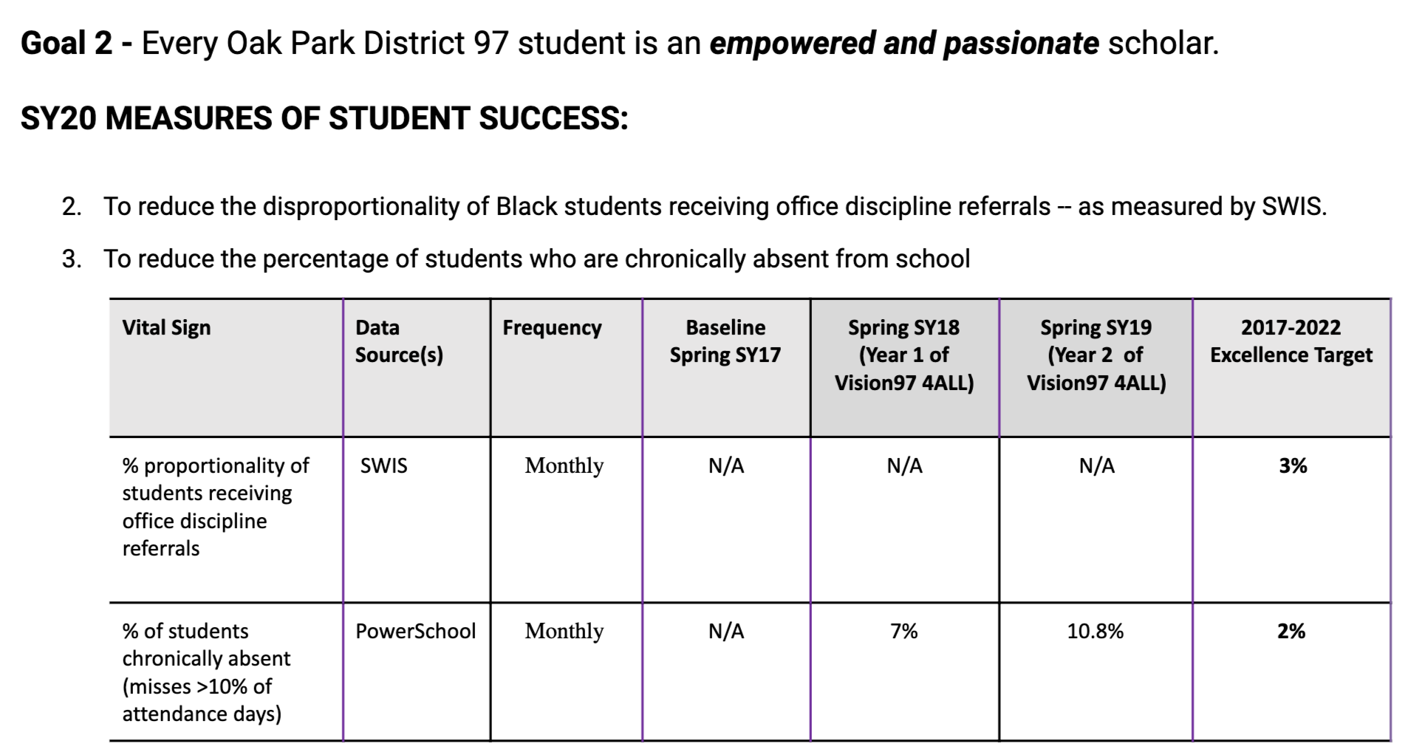
Goal 2

Slide 18
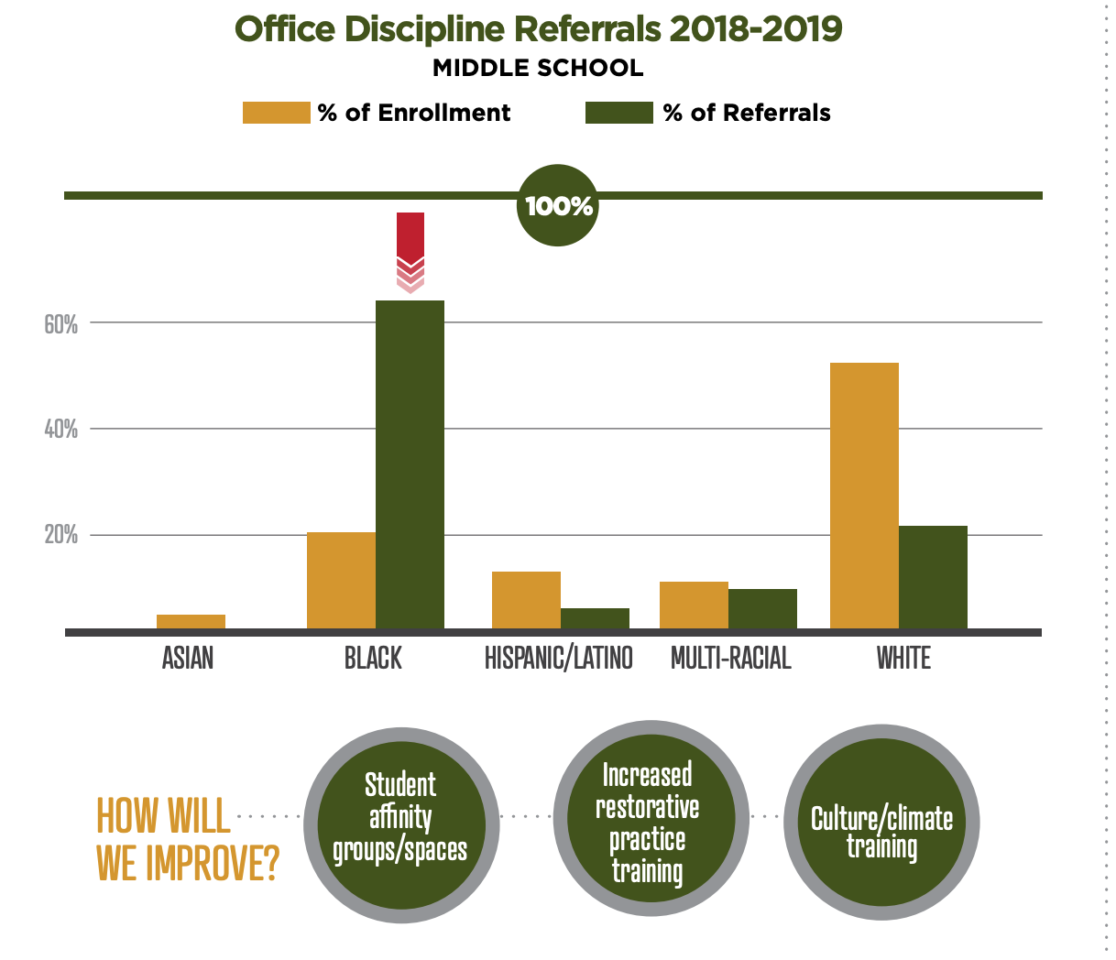
Goal 2: How Will We Address in SY20:

Slide 19
Goal 2: How will We Measure Our Activities?
Strategy - Workforce Equity
Tactic - Hire/Retain More Teachers of Color*
4.7 Teachers of Color Candidates per vacancy (15% of Candidates of Color) (by August 2020)
9.0 Male Teacher Candidates per Vacancy (22% of Male Candidates)(by August 2020)
90% Retention of 2019-2020 Teachers of Color
80% Final Round Interviews with at least one candidate of color (by May 2020)
60% Staffing Interview Panels with a minimum of 2 persons of color (by May 2020)
Notes:
* Based upon recommendations from ALMA

Slide 20
Goal 2: How will We Measure Our Activities?
Strategy - Eliminating Discipline Disproportionality
Tactic - Increase Restorative Practice Training for Staff*
100% of social workers and school psychologists trained in the delivery of interventions supportive of Trauma Informed Care (November 2019 - May 2020)**
20% of staff trained CHAMPS (August 15, 2020)
100% of schools actively use advisory, morning circles or cross-grade circles (SY20)***
Notes:
* Please click here to read D97’s full plan to implement restorative practices
* *Cognitive behavioral interventions training (CBIT & BounceBack) for social workers and psychologists allow us to deliver CBIT and BouncBack programs to identified students.

Slide 21
Goal 2: How will We Measure Our Activities?
Strategy - Eliminating Discipline Disproportionality
Tactic - Climate/Culture Training and Supports
10% of students whose end of year attendance rate was less than 90%
5% of elementary students receiving 3 or more office discipline referrals
2.06% of students receiving an in-school or out of school suspension
TBD for resources and tools staff on addressing implicit bias
Notes:
* BOE approved six (6) hallway monitors beginning SY20
* BOE approved three (3) additional climate/culture coaches
* BOE approved partnership with DePaul University [Mindful Middle School Program]

Slide 22
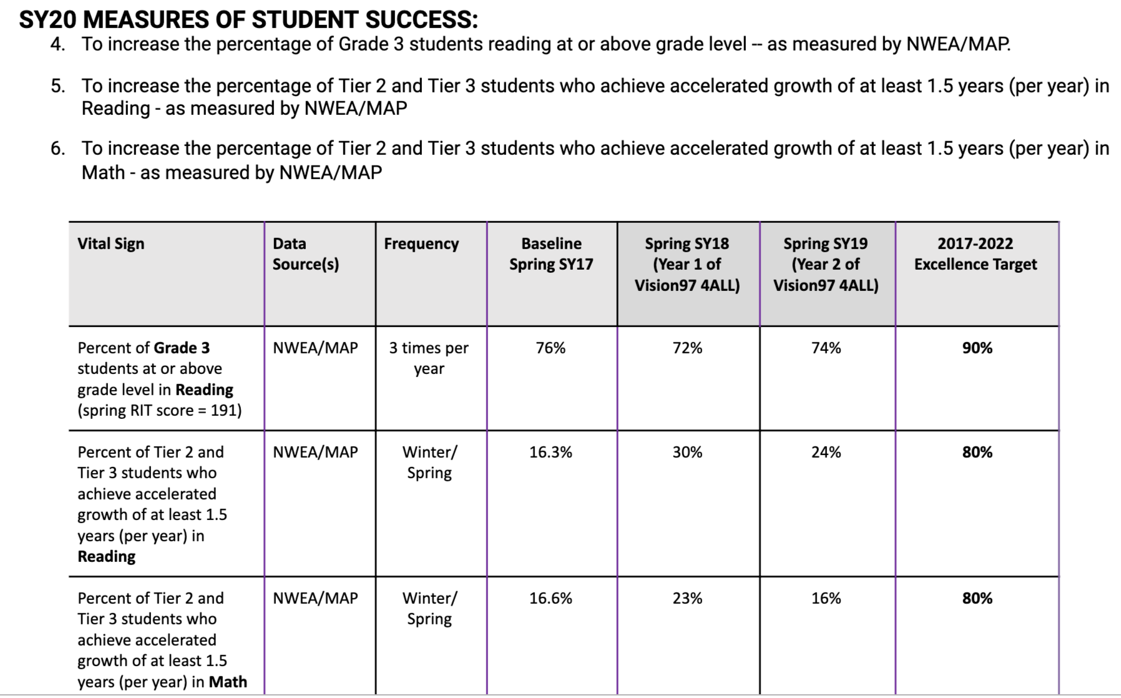
Goal 3

Slide 23
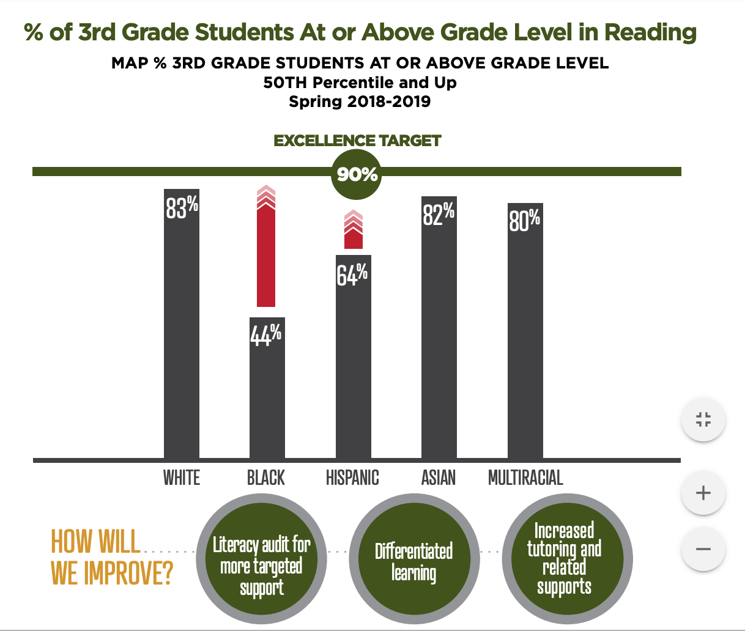
Goal 3: How Will We Address in SY20:

Slide 24
Goal 3: How will We Measure Our Activities?
Strategy - Equitable Access
Tactic - Literacy Audit & Resources for Targeted Support
100% of audit completion targets met (by May 2020)*
80% of teachers reporting comfort & confidence with use of K-5 literacy resources (September 2019 - May 2020)
75% of teachers reporting comfort with newly adopted K-5 word study resources (December 2019 and May 2020)
78 families (qualifying) with Internet for ALL (by December 2019)
Notes:
* An external partner (Dr. Tatum, UIC) will conduct a literacy audit of our classrooms in order to develop a plan of action that aligns with the goals for advancing the literacy development of students and to support teachers

Slide 25
Goal 3: How will We Measure Our Activities?
Strategy - Equitable Access
Tactic - Culturally Relevant Resources for Providing Differentiated Learning Experiences
100% Completion of ELA Written Curriculum revisions (by May 2020)
75% of K-5 teachers implement the ELA Written Curriculum with fidelity (by May 2020)

Slide 26
Goal 3: How will We Measure Our Activities?
Strategy - Professional Development
Tactic - Culturally Relevant Training for Providing Differentiated Learning Experiences
100% of instructional coaches will determine how to implement Ready for Rigor framework in their coaching with individual teachers and teams (by May 2020)
100% of district cohort (63 candidates) will complete National Board Certification components 1 and 3 (by May 2020)

Slide 27
Goal 3: How will We Measure Our Activities?
Strategy - Equitable Access
Tactic - MTSS* (aka “Increased Tutoring and Related Supports”)
At least 85% of all students identified as needing Tier 2/ 3 support will have an active plan in Branching Minds**. (September 2019 - May 2020)
Notes:
BOE approved new MTSS Director, Faith Cole, beginning July 1, 2019.
* Supports for students who are not yet at grade-level by providing Tier 3 (e.g., tutoring) options available for students who qualify. This support might look like structured in-class interventions or pullouts.
** Teachers suggested getting better student data tracking systems to assist them in knowing who needs what supports.)*

Slide 28
Goal 3: How will We Measure Our Activities?
Strategy - Equitable Access
Tactic - After-School Transportation and Online Tutoring
TBD
Notes:
* Seek potential partnership with OP Township to explore transportation options
* Partner with SPED to explore transportation options (SY21) for SPED students who attend schools outside of their attendance zones
* Explore ways to offer online extra help to students after-school (recommended by staff)

Slide 29
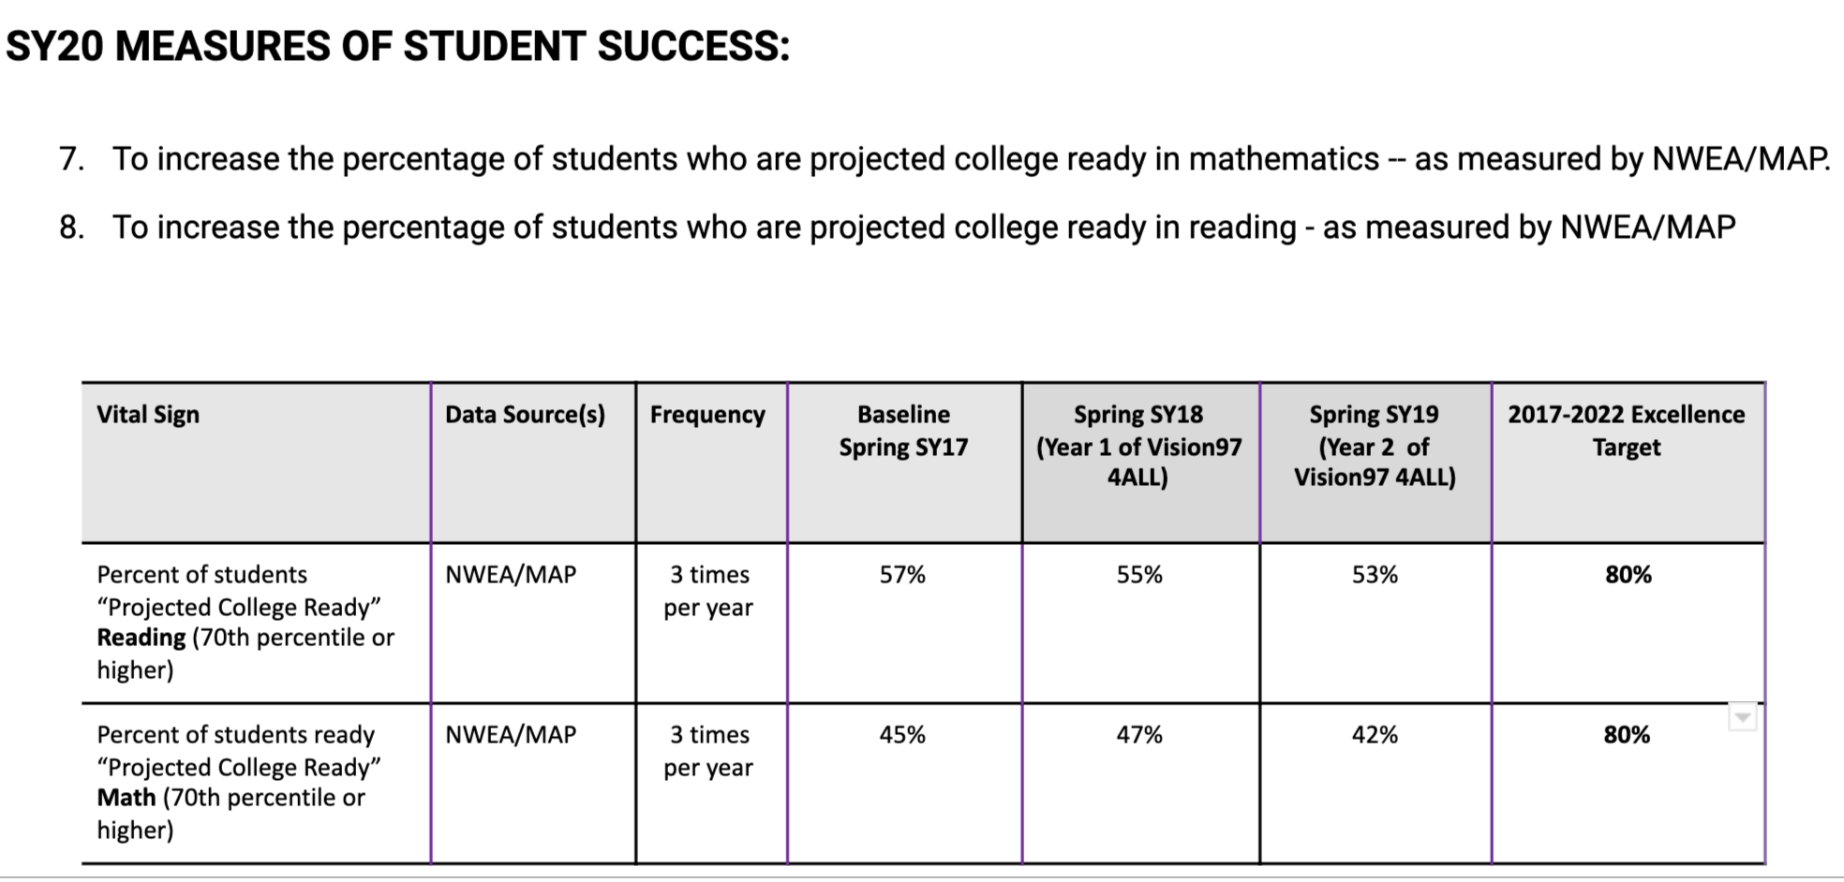
Goal 4

Slide 30
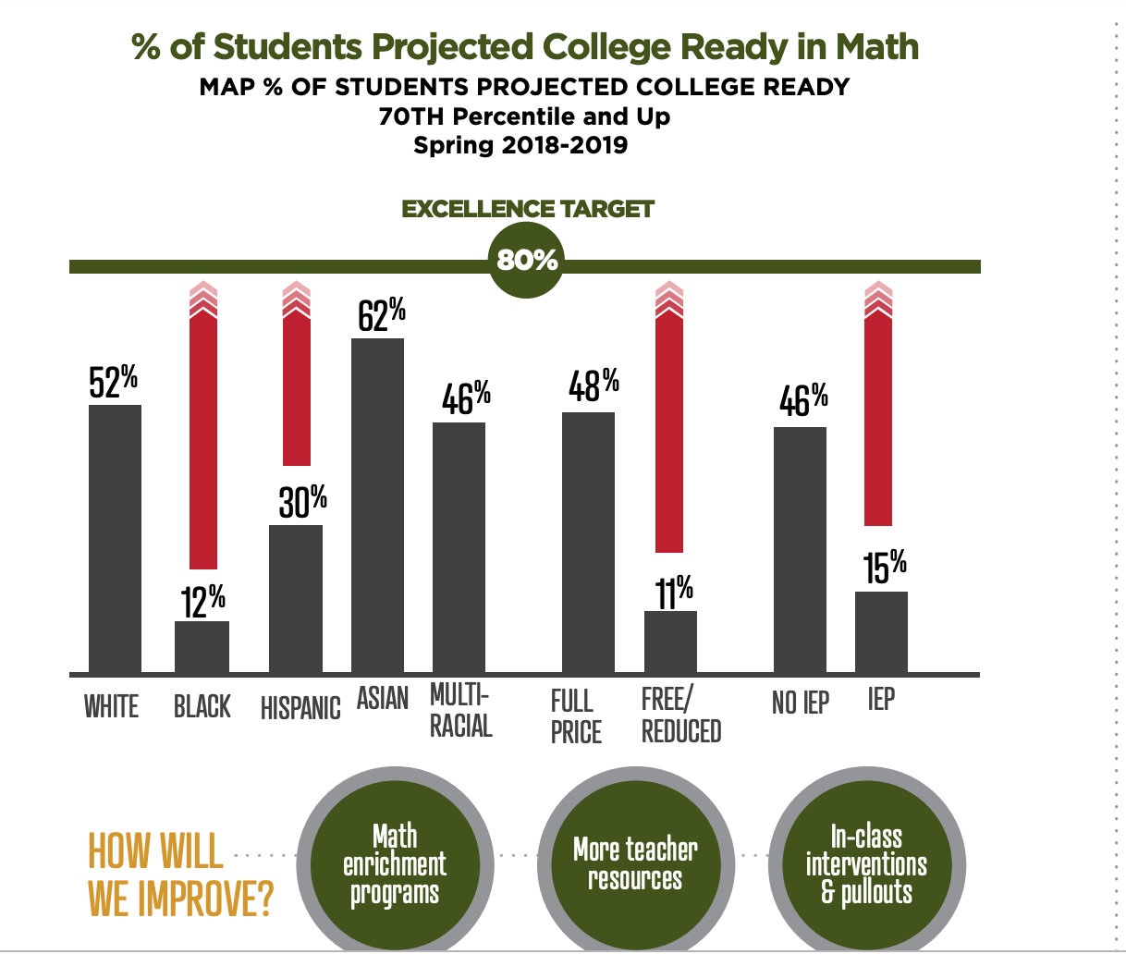
How Will We Address in SY20:

Slide 31
Goal 4: How will We Measure Our Activities?
Strategy - Equitable Access
Tactics:
Expansion of Accelerated Learning
Math Enrichment Programs and In-Class Supports
100% of requests for acceleration will be completed within the 45 - 60 school day timeline (August 2019 - May 2020)
8 out of 8 elementary schools will implement the provision of co-taught differentiated supports within the classroom as well as the redesigned “pull-out” units (August 2019 - May 2020)

Slide 32
Goal 4: How will We Measure Our Activities?
Strategy - Equitable Access
Tactic - Provide Additional Teacher Resources
10 programs reviewed to determine ROI (Return on Investment)/ROV (Return on Value) of instructional technology resource/tool (May 2020)
50 professional learning sessions provided to staff (May 2020)
100% of International Baccalaureate units and assessments will be revised (for cognitively demanding student-centered experiences). (May 2020)
Middle school reporting system will be revised to align report cards to content standards, IB components and be more student-centered. (May 2020)
100% of middle school math teachers will implement new math (CMP3) resource (October 2019 - May 2020)

Slide 33
BOE Discussion
Agreement that these are the correct big rocks?
What is the expectation from the BOE on how you would like to monitor?

Slide 34
Questions?

