Slide 1
Your Oak Park School District’s
Administration Building
STR
E N H A N C I N G N O W E N V I S I O N I N G F U T U R E S

Slide 2
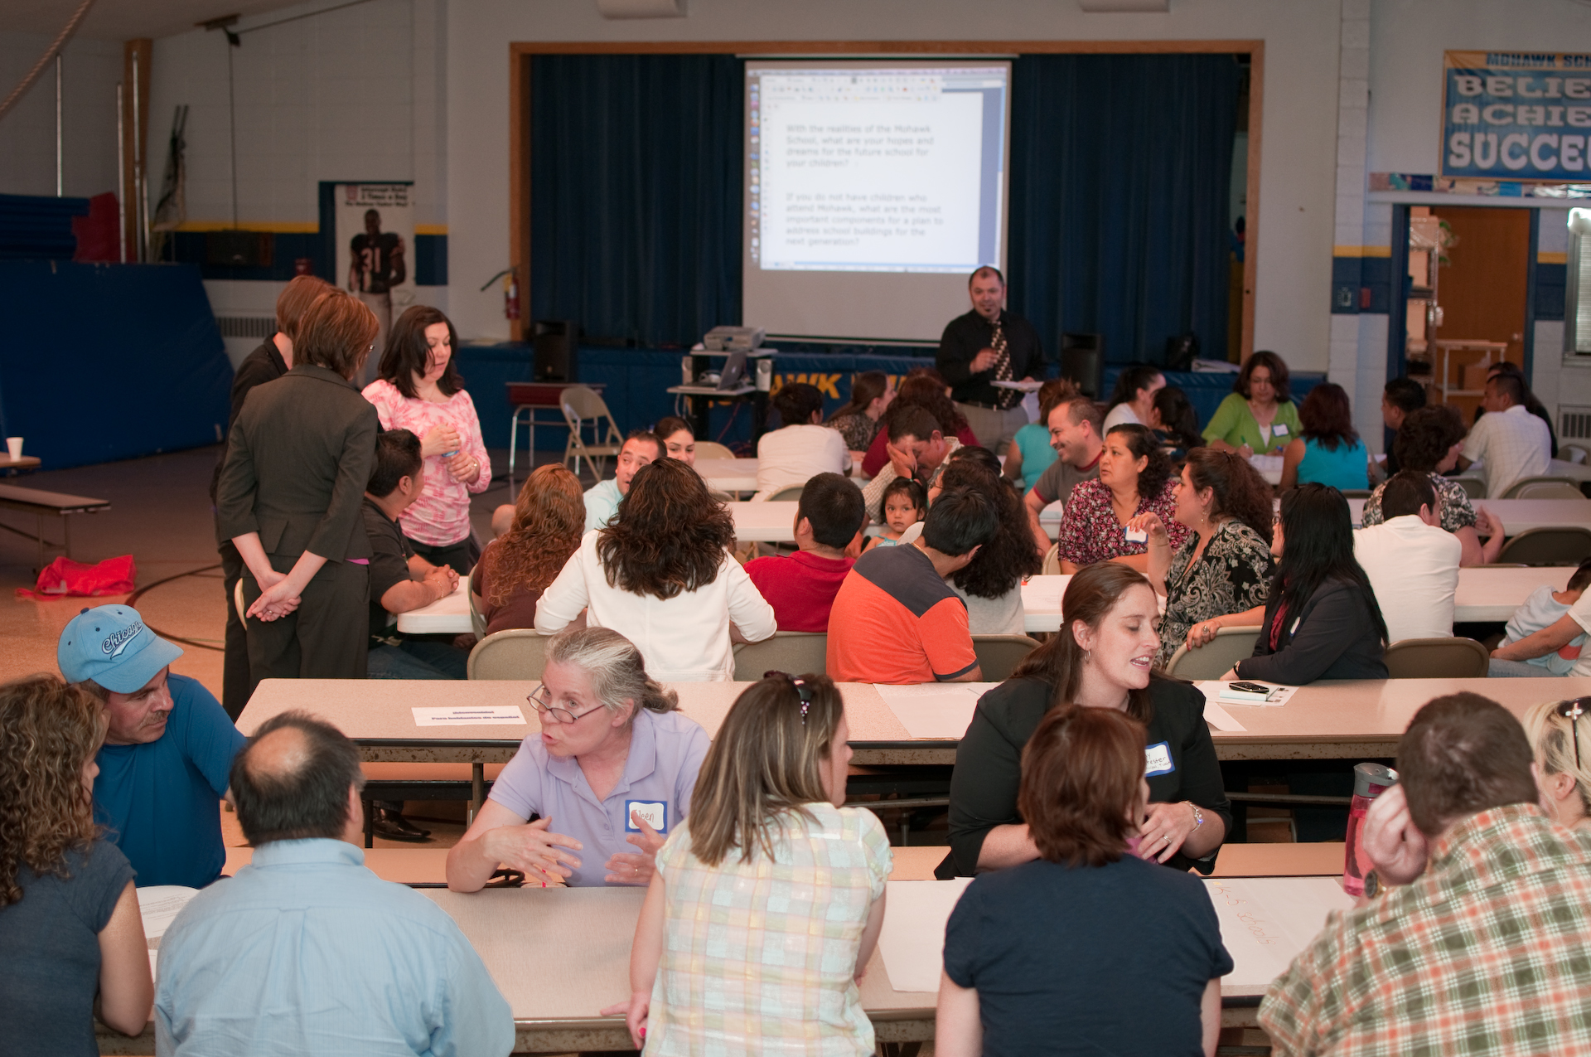
What we want to Achieve Tonight
Share What We Know
Understand What is Important to You
Schedule &

Slide 3
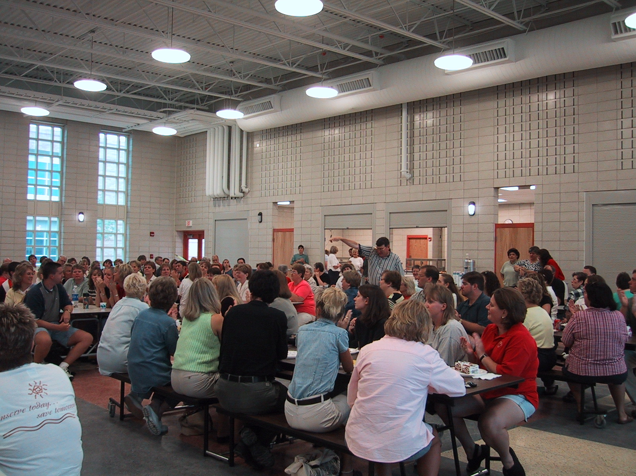
Meeting Process
2 Hours
Introduce Yourself
Be Respectful
Limit Comments so all may Talk
STR

Slide 4
Timeline
Define Goals/Needs/Wants
Focus Group#1- Dec. 11, 2014
Focus Group #2 - Dec. 18
Community Meeting #1- Feb. 5, 2015 Community Meeting #2 - Feb. 26
Design
February – June
Direct User Input/Meetings
Regular Updates to FAC & BOE
Bid
June – July
Build
August 2015 – June 2016
2-3 Months
3-4 Months
1 Month
11 Months
Occupy June, 2016
STR

Slide 5
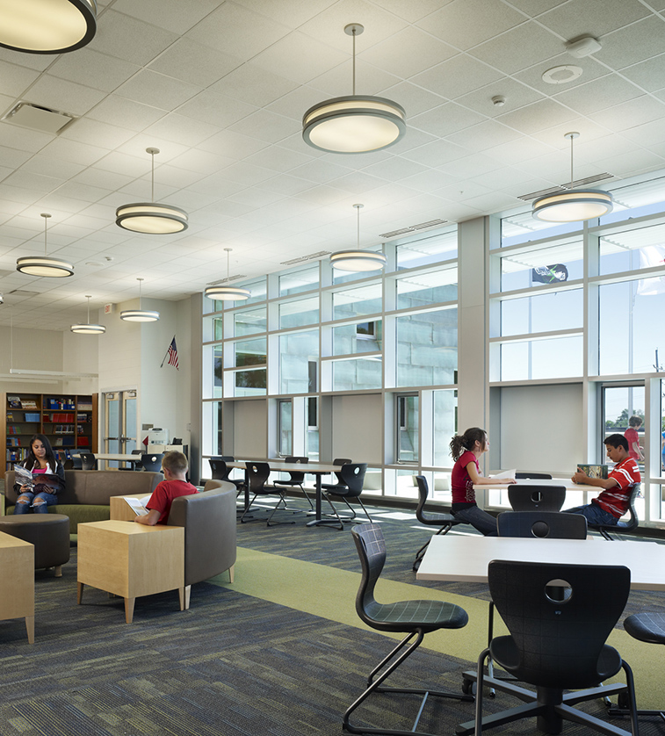
Background

Slide 6
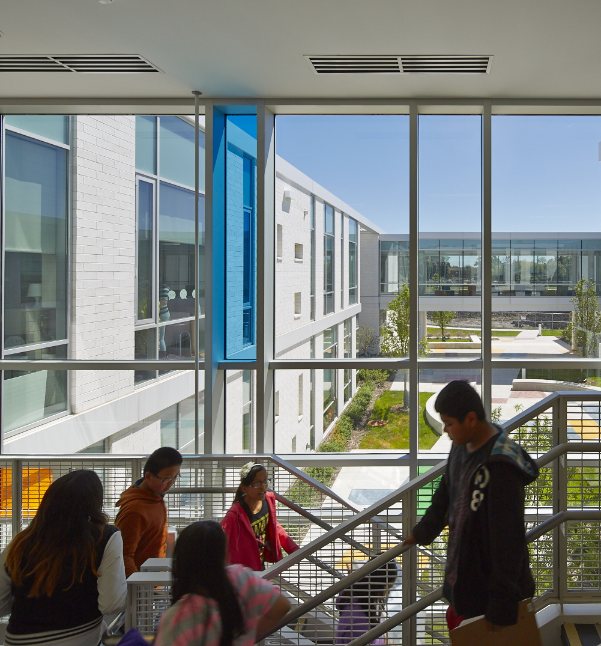
New Building
Opportunity

Slide 7
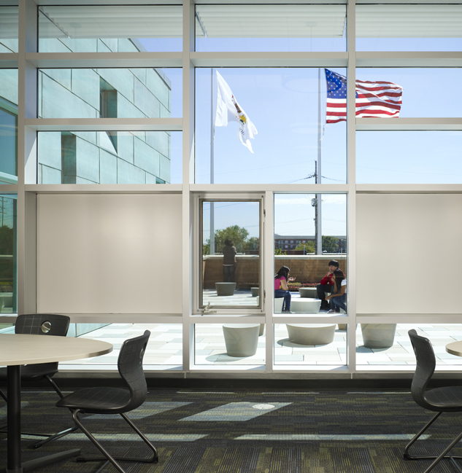
Focus Group Input
What is
Important
to You

Slide 8
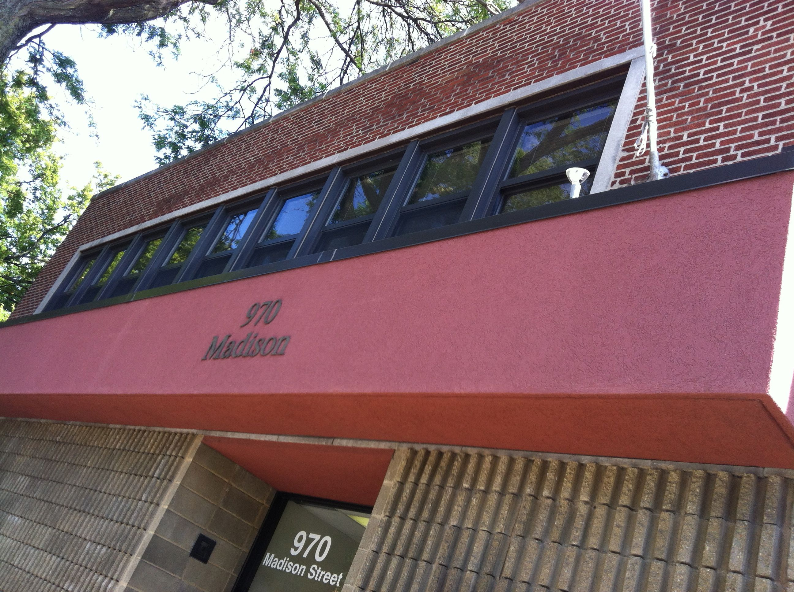
General Program
How will new building be utilized?
D97 Administration Offices
6 Departments
D97 and Community Meeting/Conference/Training Space
Student Registration
Other Potential Users
D97 Education Foundation
Multi-Cultural Center
Print Shop
STR

Slide 9
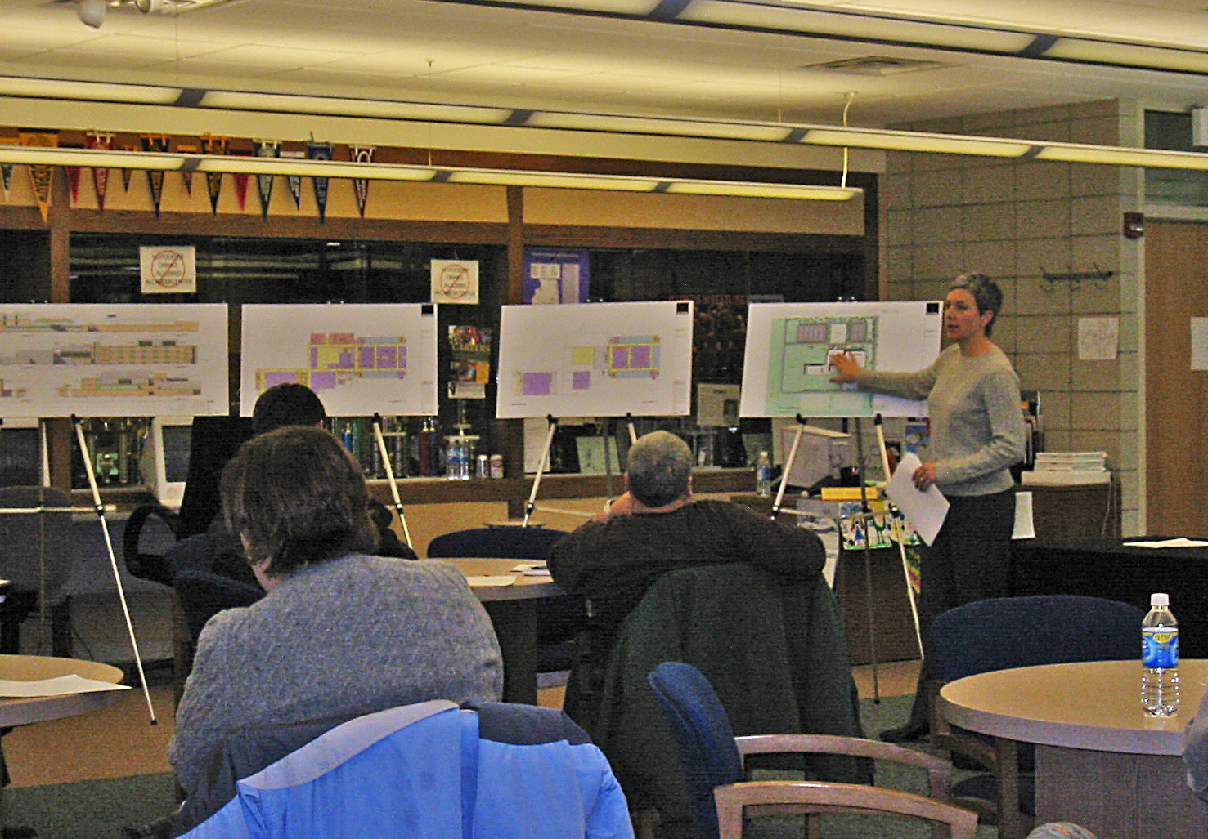
Focus Group Input
What are your expectations?
How would you define success?
What are your concerns?
Is there anything you would like to know?
STR

Slide 10
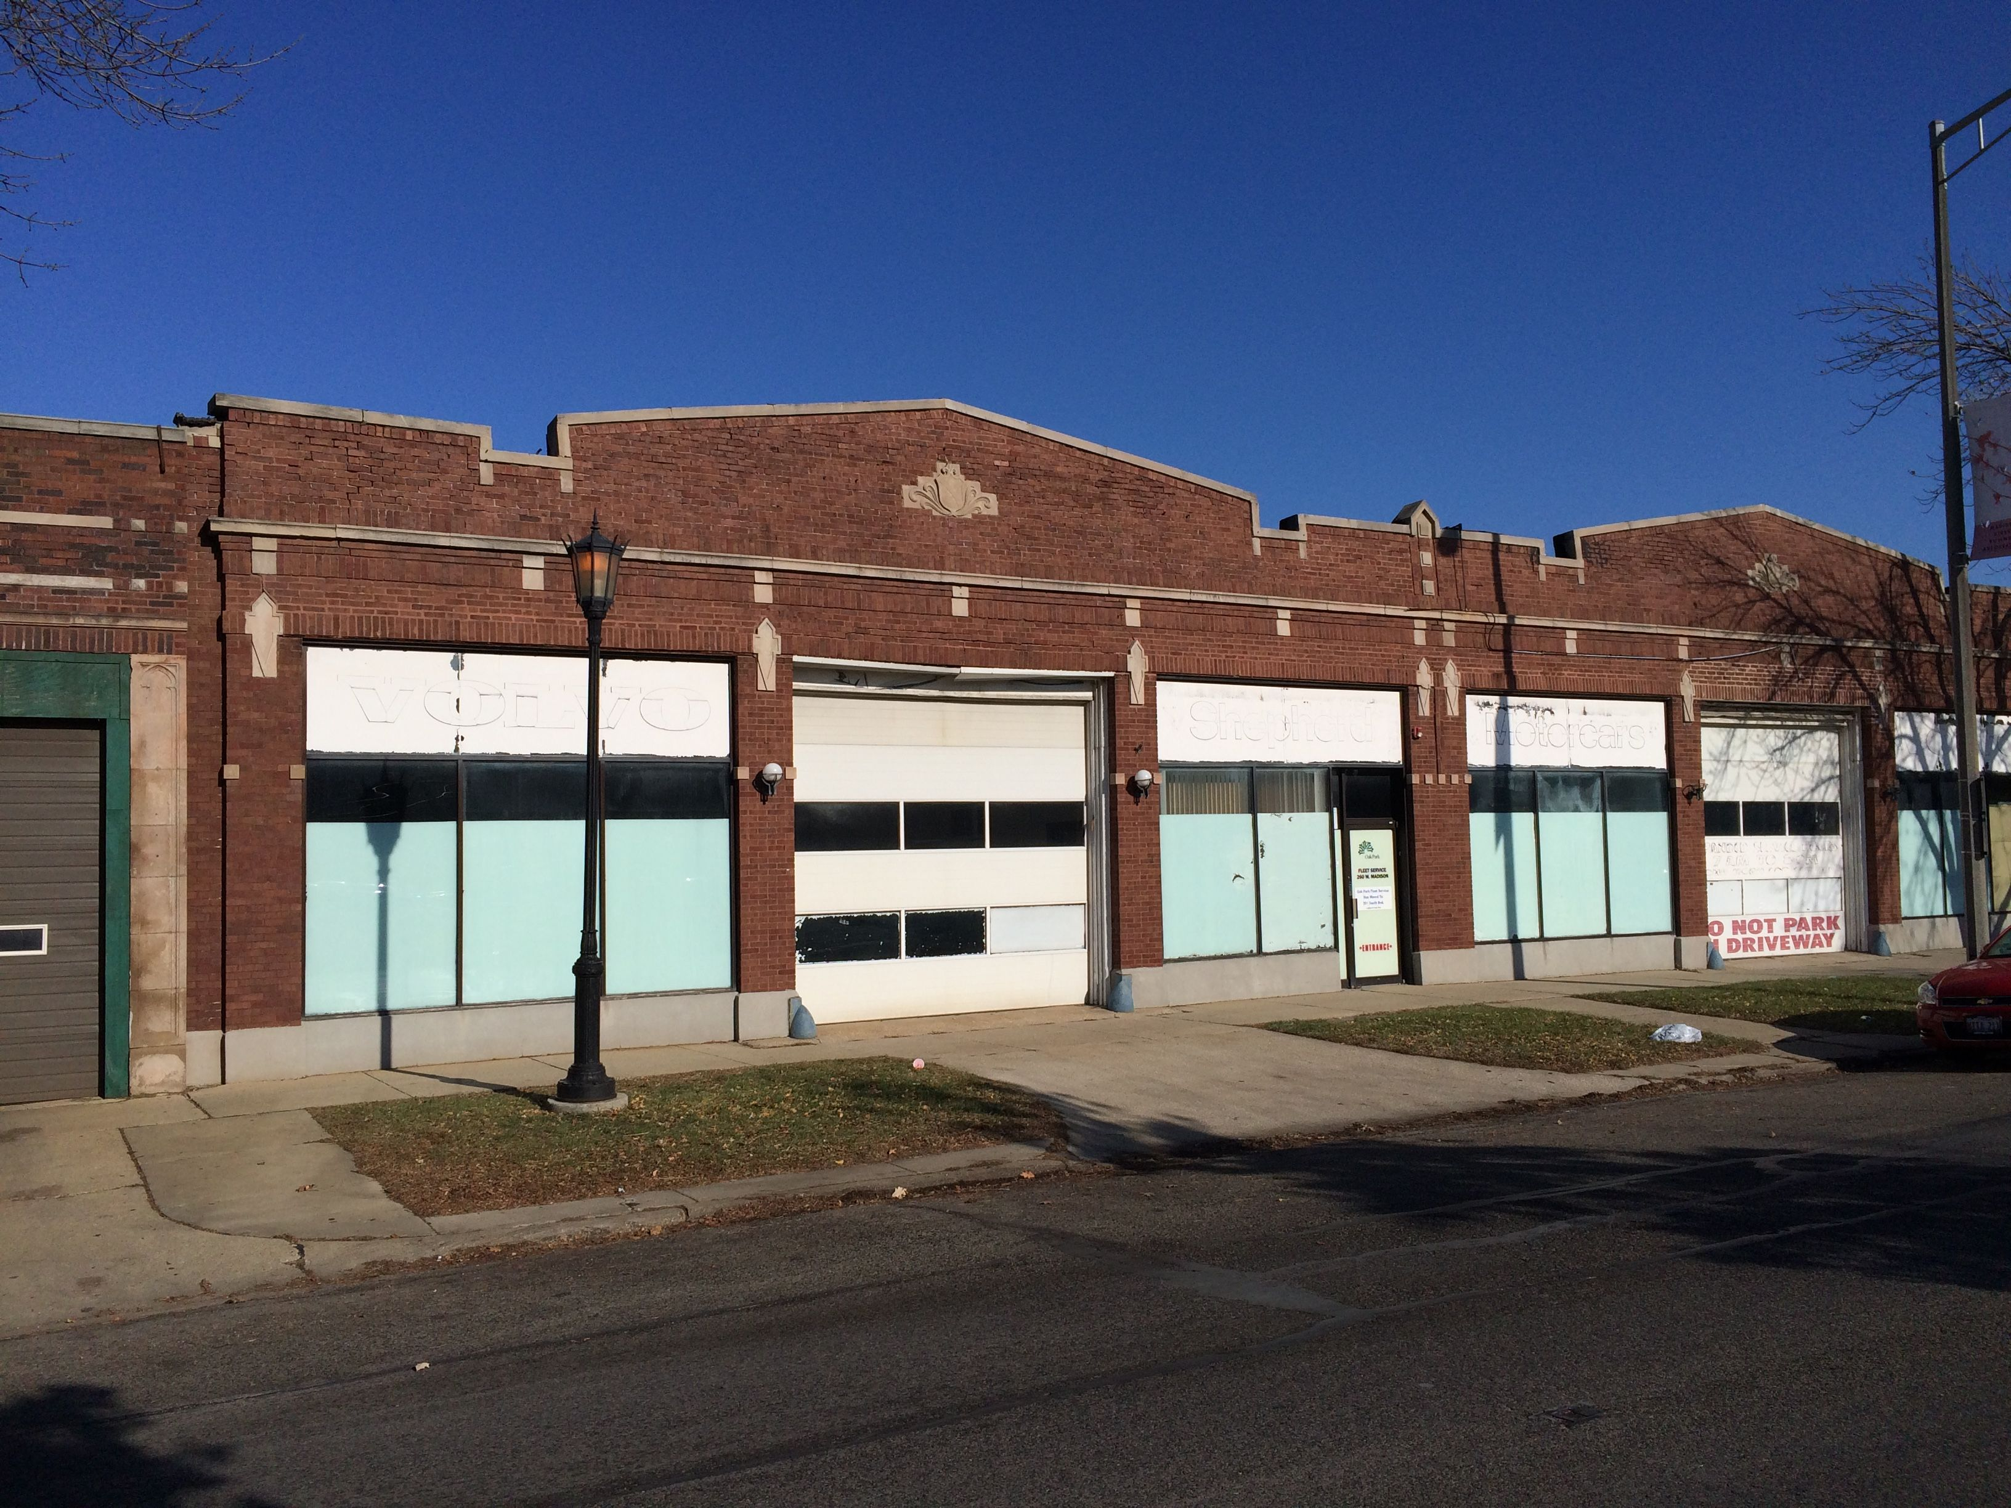
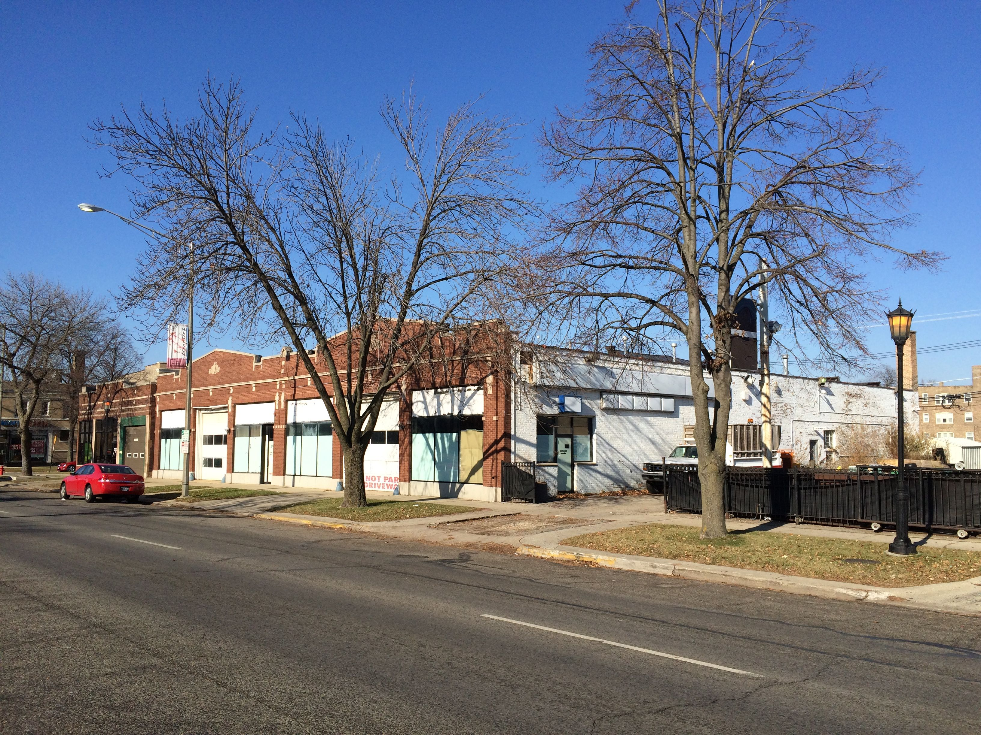
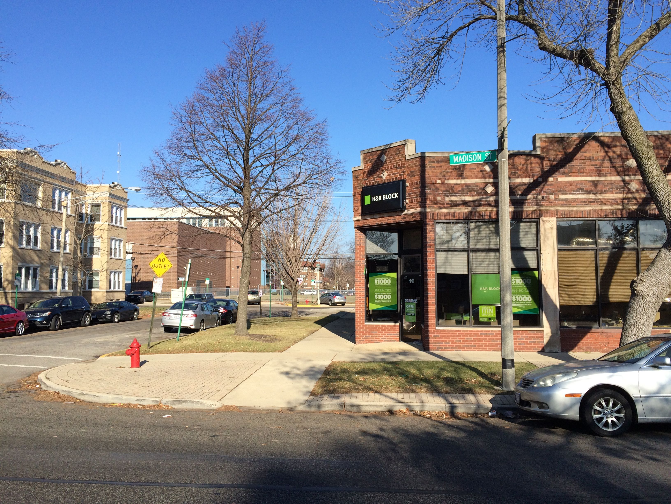
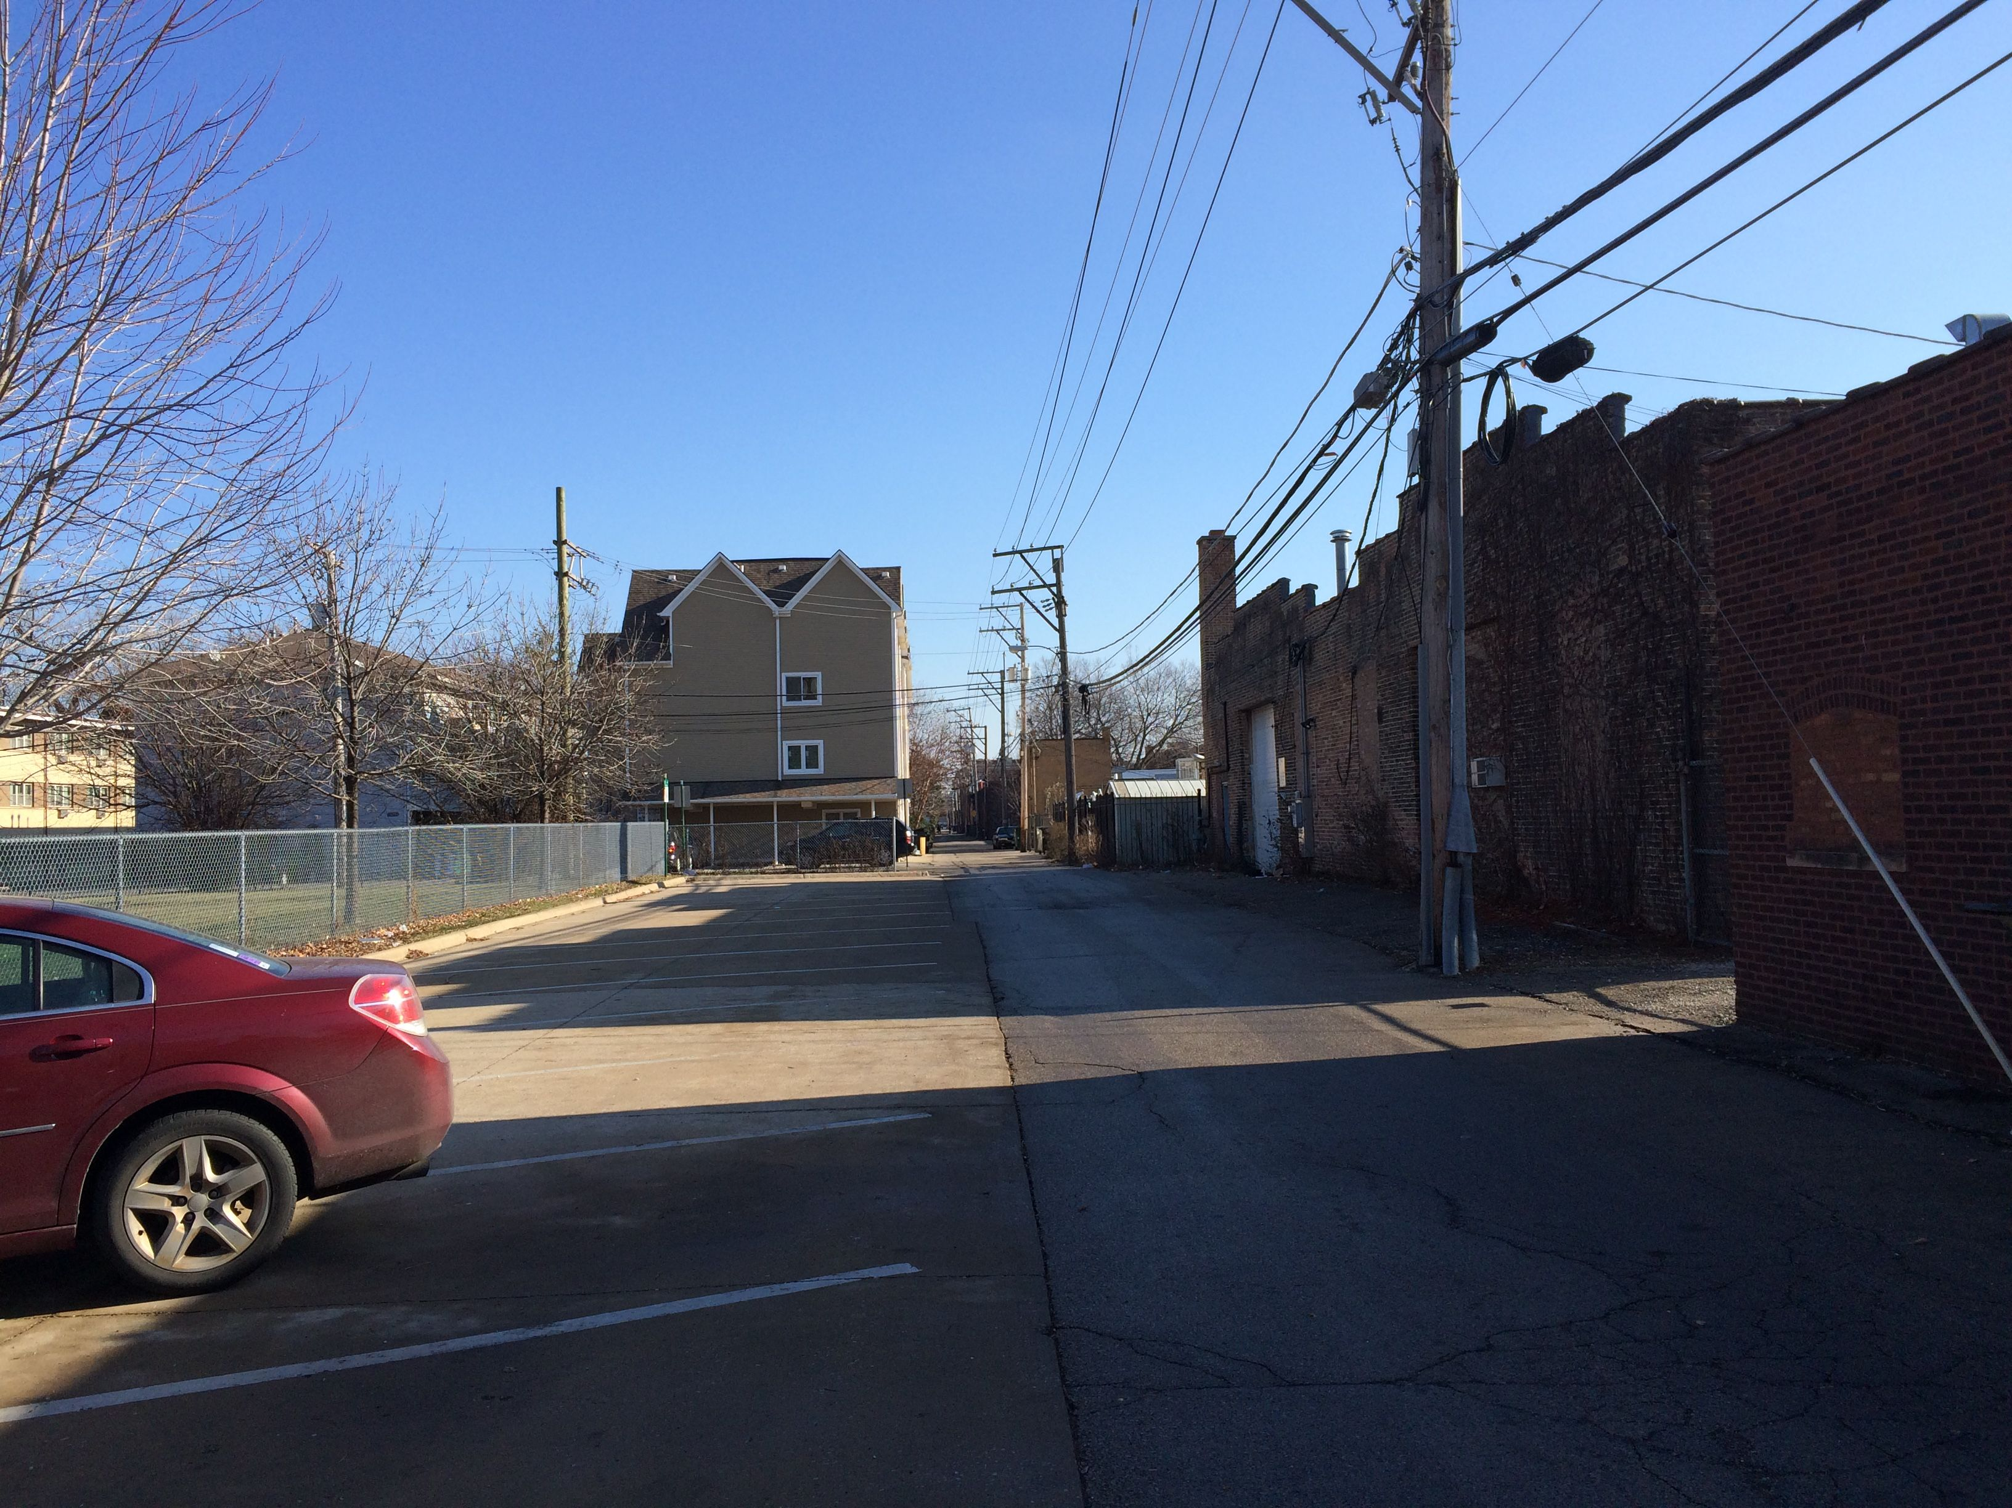
Focus Group Homework
Visit the Site – all angles
Are there others that should be included?
Contact for Further Input:
email address here
STR

Slide 11
Thank you

