Slide 1
Elementary World Language
Technology Option for Consideration
June 10, 2014
Notes:
Elementary World Language (FLES)

Slide 2
Current Elementary World Language FLES Program Model
Grades K-2:
3X week; 30 minutes each; total 90 minutes
Grades 3-5:
2X week; 30 minutes each; total 60 minutes

Slide 3
Foundation for Continuous Support for World Language Learning
FLES teachers/families have seen changes of second language acquisition with the additional hour added in K-2.
Dr. Roberts’ charge: find a way to add time (“touches”) for grades 3-5; without adding staff and using technology if possible
Notes:
Can we talk about what research says about daily “touches’ with language

Slide 4
An option to consider
Rosetta Stone Program Learning Model
Independent study model using iPads
Access to studying with Rosetta Stone during school day or at home
Individualized instruction according to each learner’s pace
Tools that measure student’s progress
Tools for parents to be informed of their child’s progress
Notes:
Allow teachers to modify - differentiate instruction in class; reinforcement

Slide 5
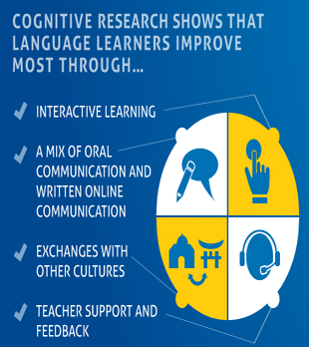
Why Rosetta Stone?
Critical listening
Speaking practice
Focused on standards-based outcomes
Notes:
Discuss other programs researched here…….
Standards -- US National standards, WIDA, ACTFL, TOEFL, TESOL and more

Slide 7
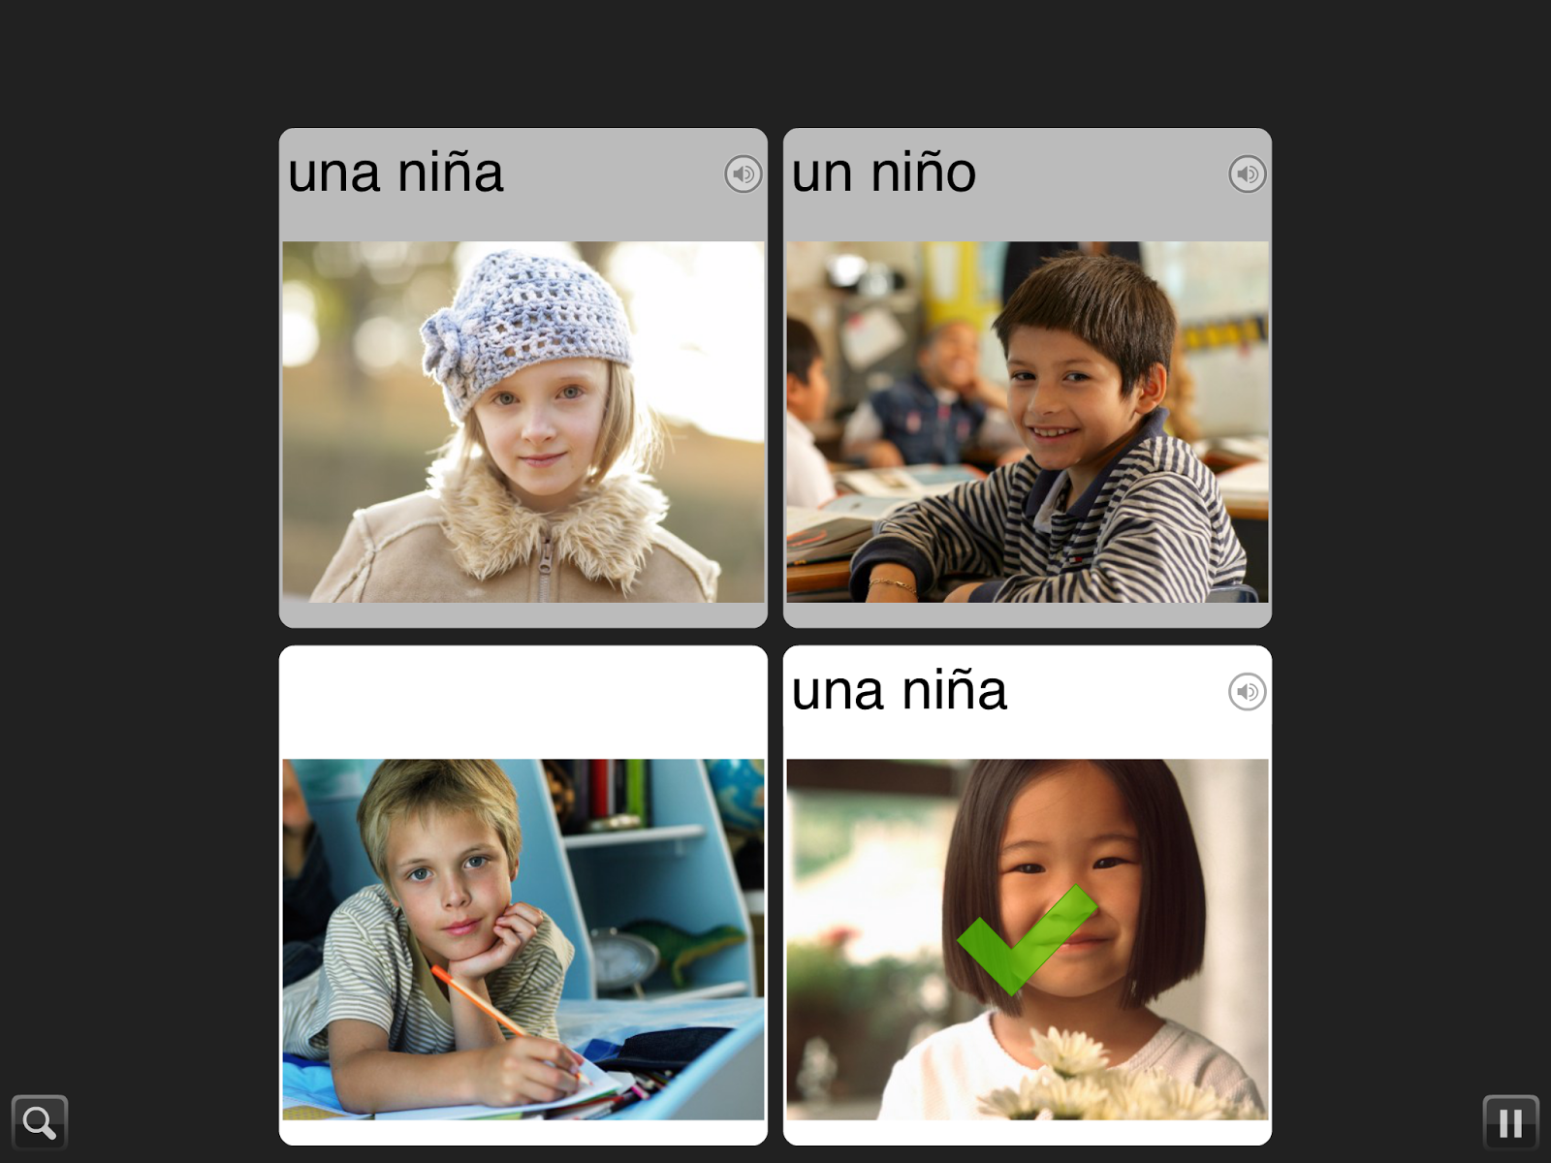

Slide 8
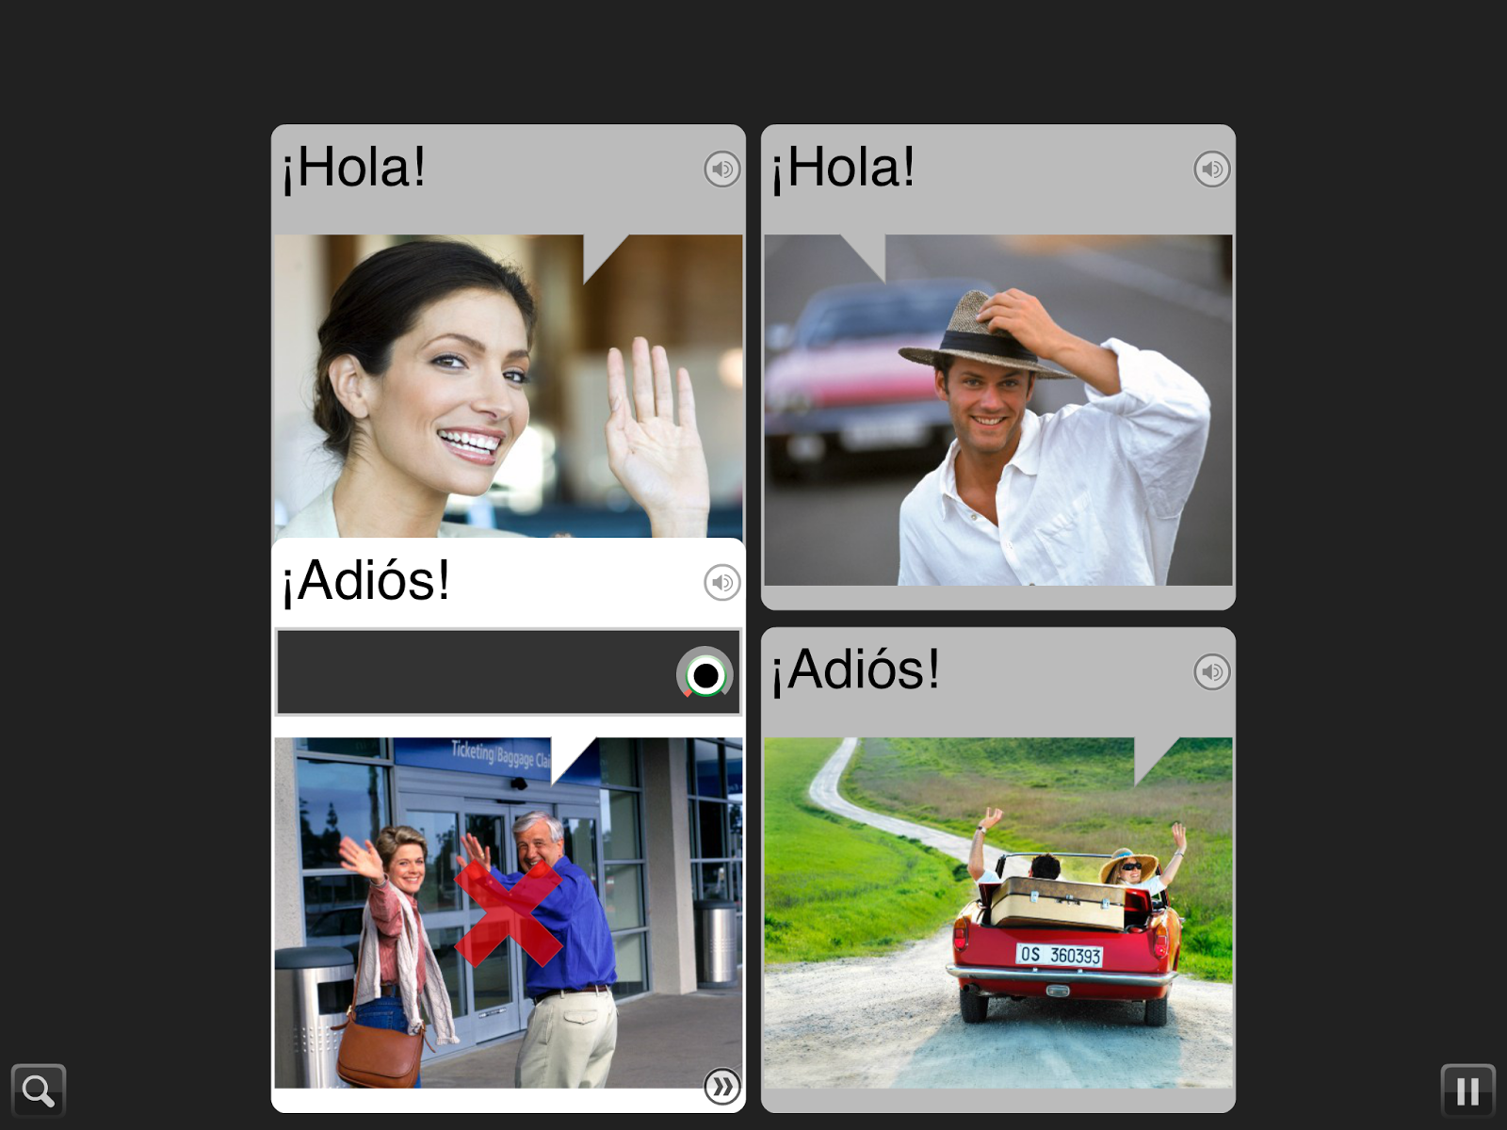

Slide 9
How could Rosetta Stone be used?
Use for 3rd-5th grade students
School (non FLES days)
Bell ringer
Center activity
Before/after school
Home
Daily homework (15 minutes)
Summer
FLES teachers to monitor progress
Notes:
Explain here why 3rd-5th,

Slide 10
Support for ELL Students
3-5 ELL D97 Students
Dual language license to support ELL instruction
Other schools districts reported:
57.3% increase in on ELL scores on ACCESS
Top 10% of learners improved ACCESS score by more than 200%
Notes:
add comments from ELL teachers here

Slide 11
Other possible options for use
Staff members
Extra-curricular before/after school programs
Possible fee-based parent subscriptions

Slide 12
Cost of Rosetta Stone
Three year site licence for 2,000 users
$131,988 (discount of $32,000 for 3 year license)
$21.99/student/year

Slide 13
Timelines for Further Discussion
Determine interest in proceeding
Provide additional information on Rosetta Stone and implementation plan

Slide 14
Questions?

