Slide 1
Oak Park School District 97
November 7, 2016
Steve Miller
Howie Crouse

Slide 2
Data Elements
Operating Fund Balances June 30 of each year
(Educational, Operations and Maintenance, Transportation, IMRF/Social Security, and Working Cash Funds)
FY17 Budget in the General Ledger is the basis of projections
Assumptions provided by the District

Slide 3
Key Revenue Assumptions
Existing EAV flat in LY16, LY17 is a reassessment year and begins pattern of 10% increase, 0%, 0%
New construction projected at $1.5M per year (each $1,000,000 of new construction generates approximately $40,000 additional operating tax revenues)
TIF expiration included as new construction in LY18 ($17.5M) and LY19 ($62.8M)
TIF Distribution in FY18 and FY19 estimated at $2.2M; $1.1M in FY20, then $0
CPI is .7% for LY16, projected at 1.5% in LY17, and 2% in subsequent years (each .5% CPI change =~$260,000 of operating tax revenues)
GSA remains at $6,119 Foundation Level and 100% proration (each 1% proration =~$100,000)
One time adjustments

Slide 4
Key Expenditure Assumptions
Salaries subject to negotiations,
New contract provisions included
Each 1% of total salary =~$560,000
Medical insurance increasing at 8.5% per year, dental 4% per year, and 403b changes tied to salary projections
Purchased services, supply and other objects expenditures increasing at CPI projected increases (1.5% then 2%)

Slide 5
Aggregate Projections

Slide 6
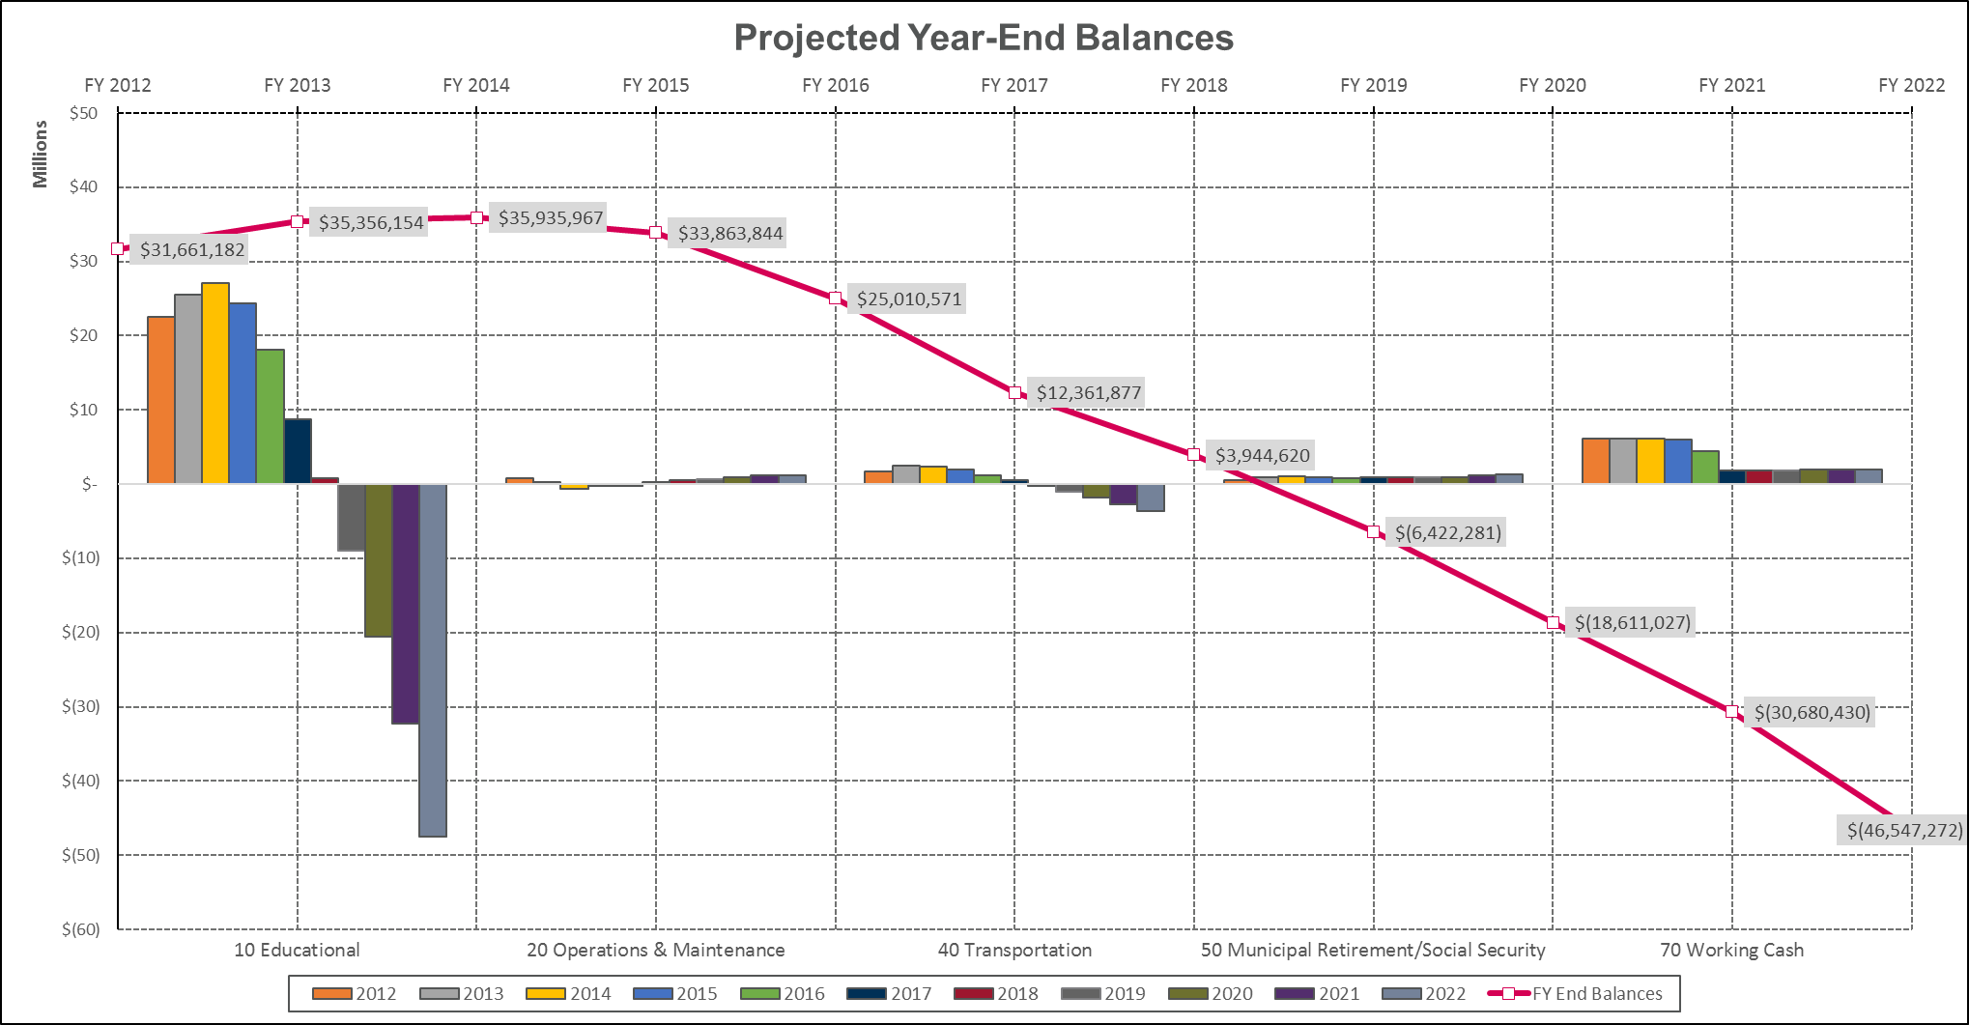
Aggregate Fund Balances

Slide 7
DISCLAIMER
The information in this presentation was prepared for informational purposes solely for client or prospective cClient (“Client”) from products or services of Forecast 5 Analytics, Inc. (F5) including 5Cast and is therefore subject to the Terms and Conditions of such products available at forecast5analytics.com.
F5 has explained the formulas and methodologies used by 5Cast and Client agrees that such formulas and methodologies are appropriate and suitable for its financial management applications. F5 has made no independent examination of the context in which the District intends to use the data from 5Cast. The data and assumptions underlying this output were provided by District. Changes to any prices, levels, or assumptions may have a material impact on results. A change in District’s fiscal policies, fundamental changes in legislative or other actions will likely also have a substantial impact on any output. At the request of Client, F5 may provide opinions or representations with respect to the financial feasibility and/or fiscal prudence of any assumptions and/or projections that Client may select and such input is subject to change without notice. Moreover, in that instance it is understood that Client is solely responsible for the decision and any associated risk of incorporating any particular assumption in its financial plan. Examples are merely representative and are not meant to be all-inclusive. F5’s analyses are not and do not purport to be appraisals of the assets, or business of Client or other entity. It is expected that the Client review the financial plan data for reasonableness, and to verify such results or otherwise seek assistance from F5 or another third party before relying on such data in such cases.
The information set forth herein was gathered from sources which F5 believes but does not guarantee to be accurate. Neither the information, nor any options expressed, constitute a solicitation for purposes of the purchase or sale of any securities or other investments and is not in any way intended to suggest/discuss potentially applicable financing applications. Investment/financing decisions by market participants should not be based on this information. F5 also does not provide legal, tax, or accounting advice. It is imperative that Client perform its own research and due diligence, independent of F5 or its affiliates, to determine the appropriateness of the proposed financial plan with respect to the aforementioned potential economic risks and legal, tax, and accounting consequences.
F5 is affiliated with PMA Financial Network, Inc., PMA Securities, Inc. and Prudent Man Advisors, Inc. (the three entities collectively being referred to as “PMA”). Securities, public finance/municipal advisory services and institutional brokerage services are offered through PMA Securities, Inc. PMA Securities, Inc. is a broker-dealer and municipal advisor registered with the SEC and MSRB, and is a member of FINRA and SIPC. Prudent Man Advisors, Inc., an SEC registered investment adviser, provides investment advisory services to local government investment pools and separate institutional accounts. All other products and services through PMA are provided by PMA Financial Network, Inc. The presenter is a registered person associated with PMA Securities.
If posted on a webpage, this information has been prepared for informational purposes and does not constitute a solicitation to purchase or sell securities, which may be done through a registered entity only after client suitability is reviewed and determined. Services offered by PMA Securities, Inc. and this registered presenter, in particular, are available only in the following state: IL. This information is not an advertisement of services available in any state other than those listed above.

