Slide 1
Supporting the Whole Child
District 97: MTSS, PBIS, & Title I
January 10, 2017

Slide 2
D97 Vision
To create a positive learning environment for all District 97 scholar that is equitable, inclusive and focused on the whole child
Notes:
Emily - there are lots of ways that we support students, the purpose of this presentation is to talk about where we are in building a multi-tiered system of supports for students

Slide 3
D97 Universal Goals
To ensure every scholar is challenged and engaged
All scholars have access to programs and supports to prepare them for success in high school
We support every scholar to be a critical thinker, ready to contribute to their community
Each scholar is known for who they are and their unique needs are met
Notes:
Emily - MTSS is a framework used to structure how we support students to achieve these universal goals

Slide 4
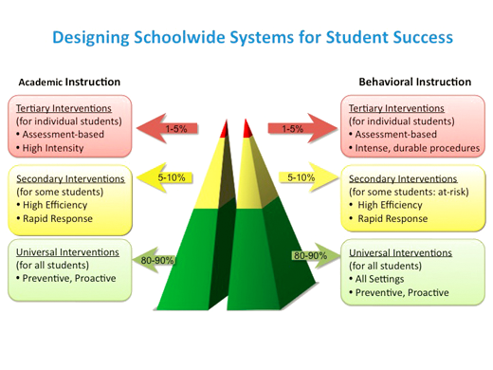
MTSS Defined:
Multi-Tiered Systems of Support (MTSS)
A coherent continuum of research based, system-wide practices to support a rapid response to academic and behavioral needs, with frequent data-based monitoring for instructional decision-making to empower each student to achieve to high standards.
Notes:
Eboney

Slide 5
Essential Components of an impactful and coordinated system of supports:
Coordinated and systematic processes for reviewing and responding to student academic and behavioral data
Progress monitoring systems that serve as both “temperature checks” and a means of informing instruction and intervention
Delivery of research based interventions with fidelity
Family, school and community partnering
Notes:
Eboney
Mention township grants as an example of community partnering.
-provide internships and scholarships
-Friday Night place
-RBT workshops (growth mindset discussion with parents)

Slide 6
Examples of MTSS Tiers of Support
Tier 1 | Eureka Math Writing Units of Study Within classroom, differentiated grouping focused on specific skills Grade-level intervention/enrichment blocks WIN (What I Need) block at Brooks/Julian Second Step
Tier 2 | Lexia Moby Max 95% Group Check-In/Check-Out WIN (What I Need) block at Brooks/Julian **In addition to Tier 1
Tier 3 | Small group or individual support Functional Assessment and Behavior Intervention Planning **In addition to Tier 1 & 2
Notes:
Carrie
Tier 3 supports provided by a myriad of staff, including special education teachers.

Slide 7
History and Principles of PBIS
The Technical Assistance Center on Positive Behavioral Interventions and Supports is established by the U.S. Department of Education's Office of Special Education Programs (OSEP) to define, develop, implement, and evaluate a multi-tiered approach to Technical Assistance that improves the capacity of states, districts and schools to establish, scale-up and sustain the PBIS framework. Emphasis is given to the impact of implementing PBIS on the social, emotional and academic outcomes for students with disabilities. The Center was established in 1998.
Core Principles:
We can effectively teach appropriate behavior to all children.
Intervene early.
Use of a multi-tier model of service delivery.
Use research-based, scientifically validated interventions to the extent available.
Monitor student progress to inform interventions.
Use data to make decisions.
Use assessment for three different purposes.
Notes:
Felicia
Began PBIS implementation in 2008. Each elementary school has a designated PBIS internal coach and a team that meets bi-weekly. The responsibilities of the building-based PBIS Teams are to:
● Develop, lead implementation of, and reinforcement of 3-5 school-wide expectations
● Review, and revise as needed, the behavioral matrix
● Coordinate and evaluate school-wide social emotional teaching
● Complete required assessments
● Enter and manage the building behavior data in SWIS
● Assist with the building reinforcement system
● Share data with building staff monthly
● Assist with communication of upcoming PBIS activities
● Engage families and community in PBIS objectives and activities
● Develop and implement Tier 2 interventions (CICO, Mentoring, etc.)
● Review student-level data to determine students in need of Tier 2
● Assign students in need of Tier 2 behavioral support to appropriate interventions
● Review the effectiveness of the Tier 2 interventions
● Adjust Tier 2 interventions as necessary
● Serve as a liaison between team and staff members

Slide 8
Goals for MTSS in 2016-2017
By July 2017:
D97 Instructional Framework is finalized and has been through a multi-stage stakeholder vetting process.
Consistent problem solving models and protocols have been selected for use across the district and documented in the Instructional Framework.
MTSS committee members have come to agreement on what academic and behavioral interventions should be consistent across the district, entrance and exit criteria for interventions, and decisions have been documented in the Instructional Framework.
Principals have received guidance on the creation of master schedules that support MTSS implementation.
A K-1 math screening tool has been piloted and recommended to the BOE for approval.
Notes:
Emily - common benchmark meeting protocol to talk about academics and behavior in the same space at the same time, building consistency and common processes

Slide 9
History of Title I
Title 1 is a supplementary federal funding program aimed to bridge the achievement gap for low-income students. Title I was first enacted in 1965 under the Elementary and Secondary Education Act (ESEA). ESEA was rewritten as No Child Left Behind (NCLB) in 2001 to improve fundamental goals of helping at-risk students. The Every Student Succeeds Act (ESSA) replaced NCLB on December 10, 2015. ESSA will be fully operational in school year 2017-2018. All of these initiatives continued to contain a Title 1 supplementary funding component.
Notes:
Felicia

Slide 10
Purpose of Title I
The purpose of Title I, the largest federally funded educational program, is to ensure that all children have a fair, equal, and significant opportunity to obtain a high quality education and reach, at a minimum, proficiency on challenging state academic achievement standards and state academic assessments
(Elementary and Secondary Education Act (2001))
Notes:
Felicia
Through Title I funds, all students have an opportunity to succeed regardless of income.

Slide 11
Basic Principles of Title I
Schools with large concentrations of low-income students will receive funds to assist in meeting the students’ educational goals by providing a continuum of supplementary services and resources.
The number of low-income students is determined by the number of students enrolled in the national free and reduced lunch program.
Notes:
Felicia

Slide 12
How can Title I funds be used?
Curriculum
Instructional activities
Counseling
Parental Involvement
Increase Staff
Program Improvement
Notes:
Felicia

Slide 13
Supplement v. Supplant
NCLB grant funds must only be used to supplement (add to) any state or local funds used to provide services, staff programs, or materials. NCLB grant funds cannot be the sole source of funding or used to pay for things that would otherwise be paid for with state or local funds.
Notes:
Felicia

Slide 14
Examples of Supplanting
Required by law
Supported last year by local dollars
Provided to everyone
Could this program or expenditure be implemented if federal funds were not available?
Notes:
Felicia

Slide 15
Targeted Assistance vs. Schoolwide Programs
Targeted Assistance - Funds are used to provide supplemental educational services only to a select group of students identified (as having the greatest need for special assistance) who are behind academically, or at risk for falling behind on the Illinois Learning Standards.
School Wide – Ensuring that all students, particularly students who are low-achieving, demonstrate at least proficient levels of achievement on the Illinois Learning Standards. At least 40% of the students enrolled in the school, or residing in the attendance area served by the school, must be from low-income families.
Notes:
Felicia

Slide 16
Fall Housing
Each year school districts must report to ISBE the number of students enrolled as of the last day in September.
Beginning with the 2008-2009 school year, the school-level fall enrollment counts are based on enrollment and exit dates reported for individual students in the ISBE Student Information System (SIS).
District 97 Title 1 schools are identified as elementary or middle schools that have a percentage of low income students that is higher than the district average.
Notes:
Felicia

Slide 17
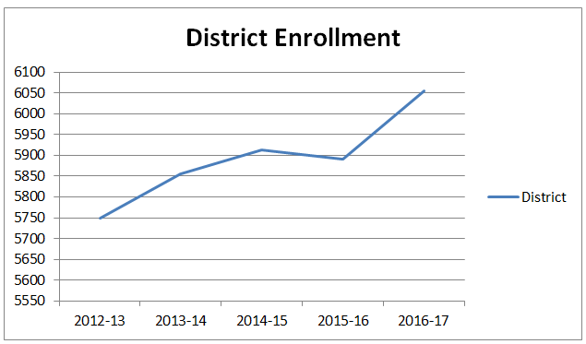
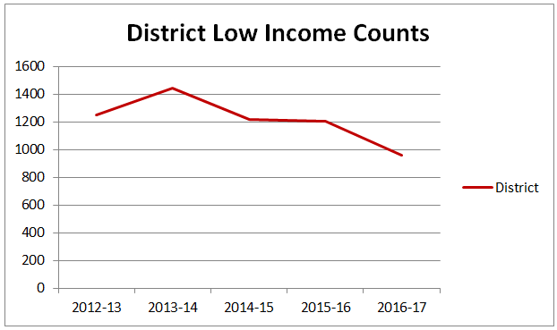
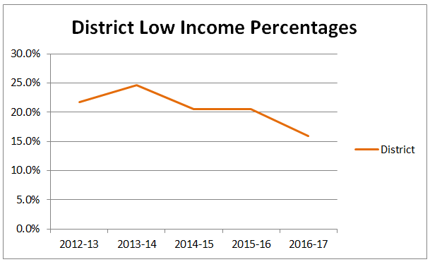
2012-13 to 2016-17 Enrollment and Low Income Trends
While enrollment has risen, students classified as low income has fallen.
Notes:
Felicia

Slide 18
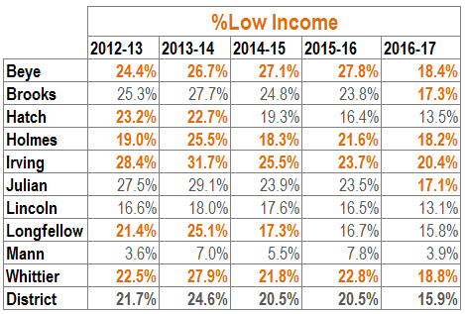
2012-13 to 2016-17 Low Income Percentage Trends
The percentage of students classified by the U.S. Department of Education as low income has fallen across the district.
In an effort to increase our Title 1 schools, in 2015-16 the district began counting students by home school (the school where the student resides). In prior years, students were counted based on the school they attended.
Notes:
Felicia
Mention Middle Schools being Title I schools beginning in 2016-2017

Slide 19
Questions/Comments?

