Slide 1
Additional Staffing Request
Effective with start of 2018-2019 school year
Presented to District 97 Board of Education
April 24, 2018

Slide 3
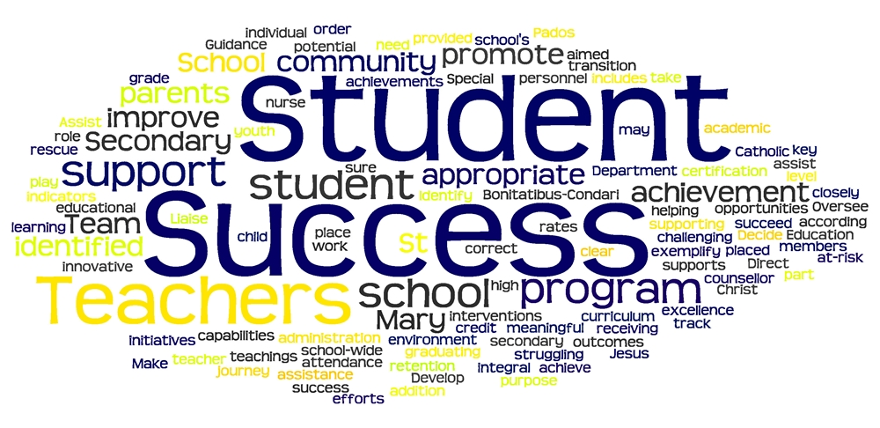

Slide 6
CLEAR, AMBITIOUS VISION FOR DISTRICT-WIDE RACIAL EQUITY
Vision97 4ALL

Slide 7
Previous Model for Allocation of Supplemental Instructional Staff
Elementary Schools - All schools get one
1 Language Arts Specialist (Interventionist)
1 Instructional Coach
1 Social Worker
1 School Librarian
1 School Nurse
1 Student Support Specialist or Assistant Principal (exception Hatch)
1 Gifted/Talented Differentiation Teacher
Notes:
Tell our story - use school sizes to illustrate this.
For the past 10 years, this has been our model.

Slide 8
Illinois Evidence-Based Funding Model for Student Success
Notes:
Provided guidance as we reviewed allocation of supplemental instructional staff

Slide 10
27 Elements
Dollar Per Student Allocations
13. Gifted and Talented Students
14. Professional Development
15. Instructional Supplies
16. Assessment
17. Computer Technology and Equipment
18. Extra Duty and Student Activities Stipends
Central Office Functions
19. Maintenance and Operations
20. Central Office Operations
21. Employee Benefits
Resources for Diverse Learners
22. Tier 2 and Tier 3 Intervention Teachers
23. Additional Pupil Support Teachers
24. Extended Day Programs
25. Summer School
26. English Learners
27. Special Education (mild and moderate disabilities)
Adequate Staffing for Core Programs
Full Day Kindergarten
Staffing Ratios for K-3 classroom teachers
Staffing Ratios for 4-12 core classroom/content teachers
Specialist Teachers
Instructional Facilitators/Coaches
Core Tier 2 and 3 Intervention Teachers
Substitute Teachers
Core Guidance Counselors and Nurses
Supervisory Aides
Librarians
Principal/Assistant Principal
School Site Secretarial Staff
Notes:
Quick view of the 27 factors from the model

Slide 11
Overview of Additional Staffing Request
Replace Student Support Specialists with Assistant Principals at Irving & Holmes
Add a Student Support Specialist at Hatch
Add 4 Social Workers and 1 School Psychologist
Addition of 4 Special Education Teachers
Addition of 3 Multi-Tiered System of Support Interventionists
Notes:
Based on:
Feedback from staff at larger schools that their enrollment has been growing but the support system hasn’t changed
Our review of staffing in light of the Evidence-Based Funding Model
The growing enrollments at our schools
Our work strengthening multi-tiered support to our larger schools, and
Expansion of the co-teaching model for special education.
Members of the Cabinet Team will take a few minutes to review each of these recommendations.

Slide 12
Increased Support for Elementary School Operations and Evaluations
The addition of two assistant principals and one student support specialist is intended to address:
Instructional Leadership Focus
Evaluation Support
Supported by Evidence Based Funding Model
All buildings would be supported by an Assistant Principal or Student Support Specialists
Notes:
Amy

Slide 13
Supporting Social/Emotional Needs of Students
The addition of four social workers and one school psychologist is intended to address:
Increasing enrollment trends
Increased complexity of student need (regardless of disability status)
Seamless implementation of Tier 3 behavioral interventions
Support of MTSS implementation

Slide 14
Expanding the Special Education Co-Teaching Model
The addition of four special education teachers is intended to expand the existing co-teaching pilot. Co-teaching is in close alignment with the District 97 vision to provide a positive learning environment that is equitable, inclusive and focused on the whole child. In addition, co-teaching:
Provides meaningful access to the general education curriculum
Provides additional instructional support
Provides opportunities to learn from peers
Provides additional opportunities for social interactions
Increases respect and understanding for all students

Slide 15
Expanding the Special Education Co-Teaching Model , cont.
Eliminates the stigma often associated with special education
Places value on diversity
Allows for school staff to have the training, support and resources to nurture, encourage and respond to the needs of all students.
Ensures that every child feels safe and possesses a sense of belonging

Slide 16
Providing Additional MTSS Support at Larger Elementary Schools
Provides Tier 3 intervention support to students in reading and/or math
Works with students in small groups or 1-1
Addresses staffing inequities that exist between our smaller and larger schools (Holmes, Longfellow, Lincoln)
Request: One additional MTSS interventionist at each school-Lincoln, Longfellow, Holmes

Slide 17
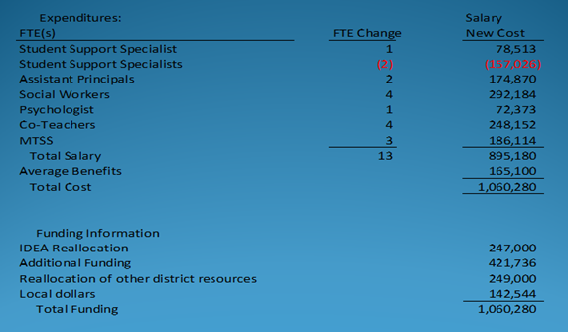
Financial Implications
Notes:
Tell a story about this issue. About how we got here.
Discuss the cost almost neutral information between the SSS and the AP (450:1) EBF
Discuss how the new positions will impact the overall budget
Discuss the average cost per category - varies depending on the group (could bring a different level of skills that would warrant a higher salary that a first year teacher)
Discuss the positions will be funded with reallocation of resources and new money
What are the things we looked at reducing. Measurement of student outcomes
Discuss the reallocation for dollars and the concept of scarcity

Slide 18
Opportunity Costs
Educational Equity should be measured by student outcomes
Tier One for Behavior
Support of English Learners
Expanding Co-teaching and social emotional learning
Invest in people and activities to improve outcomes for all students
Deficit spending should not be a option in the education fund (resources are limited)
When a new item is considered, there is a process for looking at ways to fund new initiatives
Additional staffing will add to the budget if there is no reallocation of dollars
Focused budgets on the priorities for next year
In order to maintain long-term financial solvency the administration will phase in changes over time by being thoughtful and deliberate in our approach to staffing
Other resource allocations
Investing in training of staff (train the trainer model)
Notes:
Education equity: As data on academic achievement and other students outcomes are disaggregated and analyzed, one sees high comparable performance for all identifiable groups of learners, and achievement/performance gaps are virtually non-existent.

Slide 19
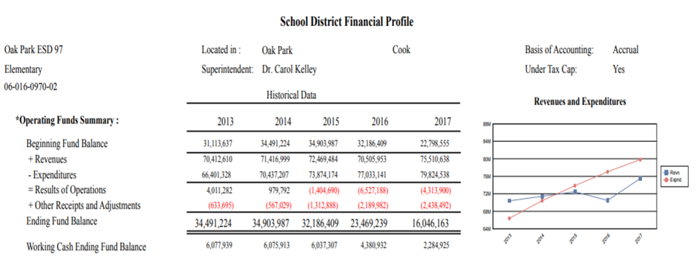
History

Slide 20
Questions from the Board

