Slide 1
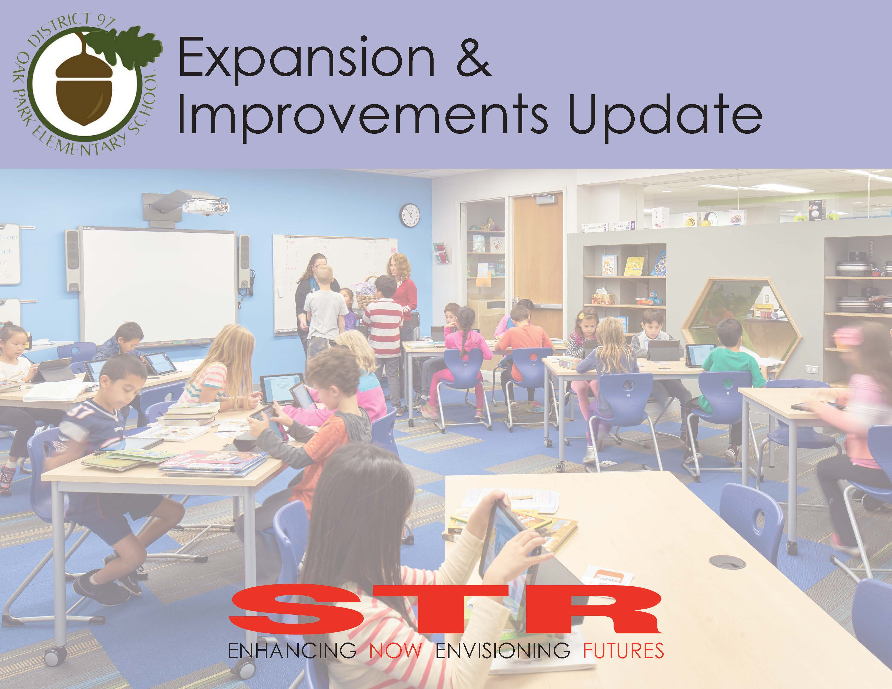

Slide 2
Agenda
Overview
Explorations since 5/8 meeting
Lincoln Concept Design Options
Option B
Option C
Option B1
Longfellow Concept Design
2019 – 2021 Intended Projects
Scope Description
Cost Estimates
Questions

Slide 3
LINCOLN Concept Design: Option B

Slide 4
LINCOLN Concept Design: Option B

Slide 5

LINCOLN Concept Design: Option B

Slide 6
LINCOLN Concept Design: Option C

Slide 7
LINCOLN Concept Design: Option C

Slide 8
LINCOLN Concept Design: Option C

Slide 9
LINCOLN Concept Design: Option B1
4

Slide 10
LINCOLN Concept Design: Option B1
4

Slide 11
LINCOLN Concept Design: Option B1
4

Slide 12
LONGFELLOW Concept Design

Slide 13
LONGFELLOW Concept Design

Slide 14
LONGFELLOW Concept Design

Slide 15
Identified Projects thru 2021

Slide 16
Estimated Expenditures: 3-Year Projections
Projected Expenditures Assuming Lincoln Option B
Projected Expenditures Assuming Lincoln Option C

Slide 17
Estimated Expenditures: 3-Year Projections Option B.1
Projected Expenditures Assuming Lincoln Option B.1

Slide 18

Questions?

Slide 19
Facility Utilization as of May 31, 2018

Slide 20
LINCOLN Option B: Analysis of Classroom Quantity

Slide 21
LINCOLN Option C: Analysis of Classroom Quantity

Slide 22
LONGFELLOW: Analysis of Classroom Quantity

Slide 23
LONGFELLOW: Analysis of Classroom Quantity w/Aides

