Slide 1
Welcome to the
2017-18 School Year!
“Unlocking Student
Potential”
SY18 District Action Plan Presentation (BOE Update)

Slide 2
#vision97 4ALL
Unlocking Student Potential

Slide 3
#vision97
Our vision in District 97 is to create a positive learning environment for all students that is equitable, inclusive and focused on the whole child.
Unlocking Student Potential

Slide 4
We will help every D97 student experience or achieve the following goals:
Known, nurtured and celebrated LEARNER
Empowered and passionate SCHOLAR
Confident and persistent ACHIEVER
Creative CRITICAL THINKER & GLOBAL CITIZEN
Unlocking Student Potential

Slide 5
Strategic Directions
PILLAR 1: Equitable Access to Rigorous, Responsive Instruction
PILLAR 2: Strong Relationships with Families and Community
PILLAR 3: Effective Teachers, Leaders and Staff for Every Student, for Every School
PILLAR 4: Data-Driven Continuous Improvement
Unlocking Student Potential

Slide 6
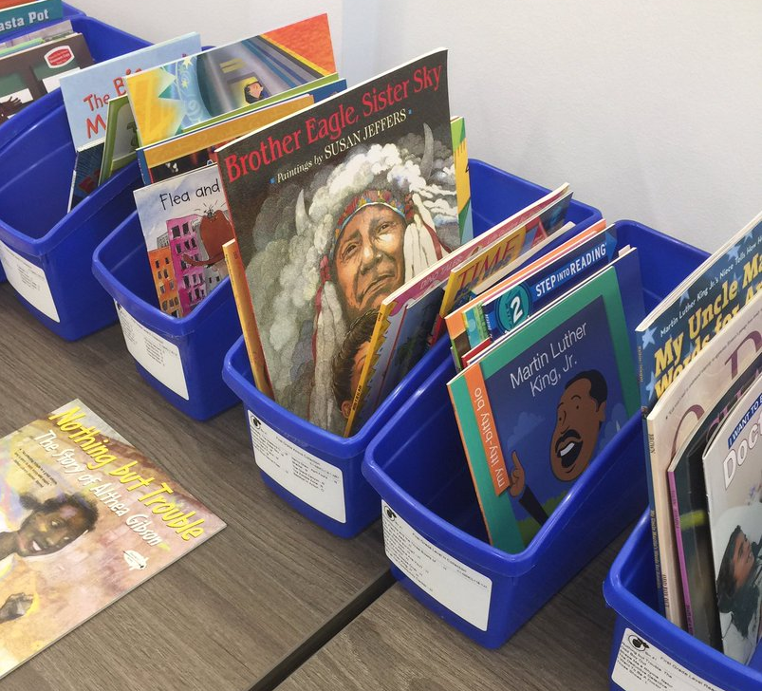
PILLAR 1: Equitable Access to Rigorous, Responsive Instruction
Reading Units of Study (K-2)
Computational Thinking
(6-8 Science)
Unlocking Student Potential

Slide 7
PILLAR 2: Strong Relationships with Families and Community
Unlocking Student Potential

Slide 8
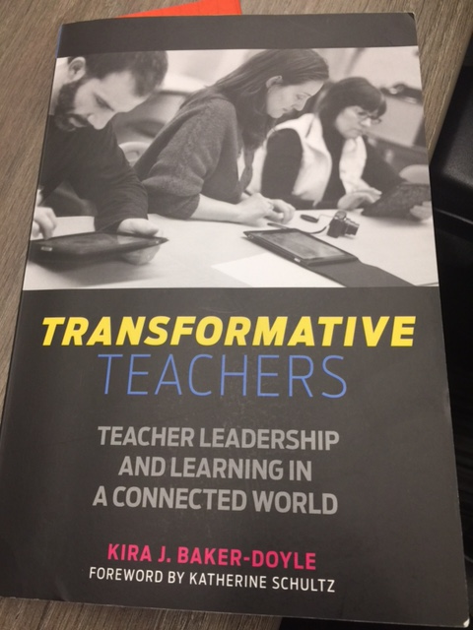
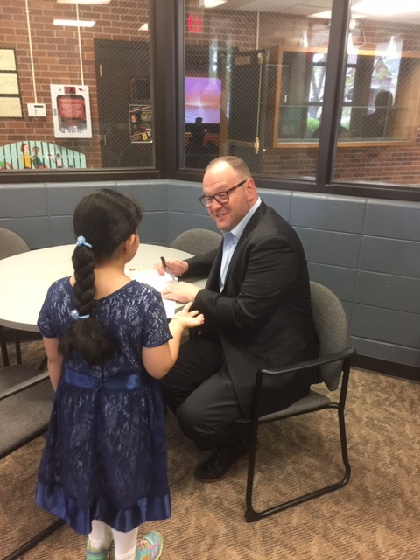
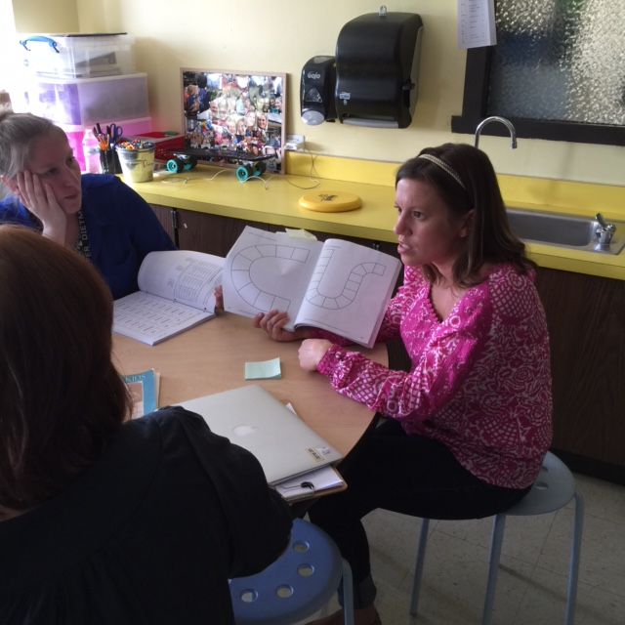
PILLAR 3: Effective Teachers, Leaders and Staff for Every Student, for Every School
Unlocking Student Potential

Slide 9
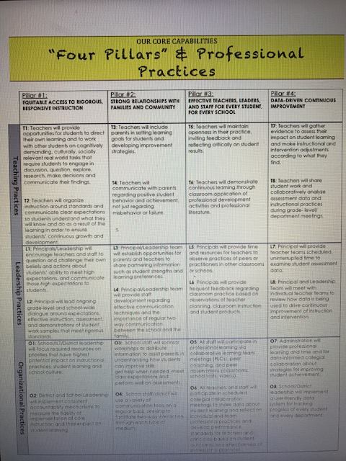
PILLAR 4: Data-Informed Continuous Improvement
Unlocking Student Potential

Slide 10
#vision97 4ALL
Unlocking Student Potential

Slide 11
“Unlocking Student Potential”
It Is Time!
All Meaningful and Lasting Change Begins on the Inside.
Martin Luther King Jr.
Image credit: flickr.com/ky_olsen
Source: NEP 2017

